Slide 1
Advanced Topics in Visual Computing
Deep Learning for
General Object Detection

Slide 2
Outline
Problem Definition
General Pipeline
Traditional Approaches
Deep Learning based Approaches
Unsolved Problems

Slide 3
Problem Definition

Slide 4
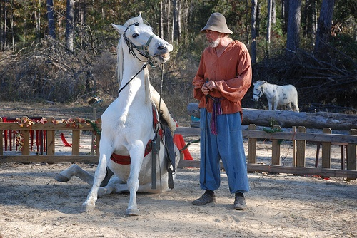
What is Object Detection?
Object Detection: Which objects and where?
Localize and recognize the object inside the input image
.
Person
Horse
Horse

Slide 5
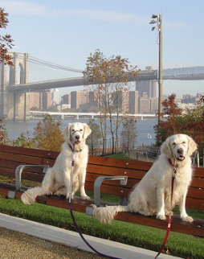
What is Object Detection?
Image Classification vs Object Detection.
Dog
Dog
Dog
Slides from Ross Girshick, 2014

Slide 6
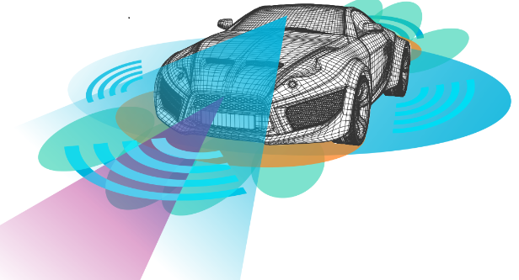
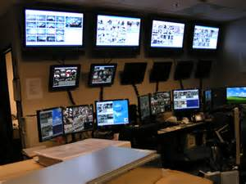
Application
Applications: Advanced Driver Assistance Systems, Video Surveillance, Multi-object Tracking, Image Retrieval etc.

Slide 7
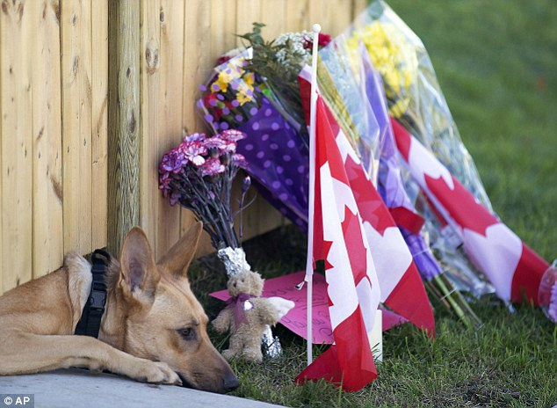
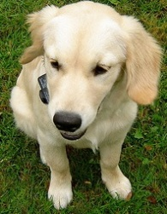
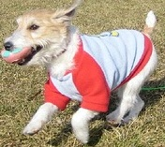
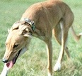
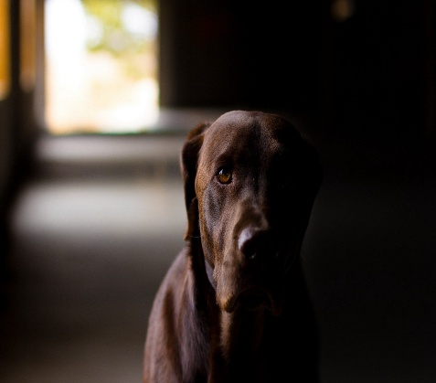
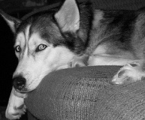
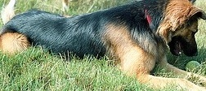
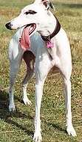
Object Detection is Challenging
The large variation of object appearances
Scene/Background clutter
Variations in shape, scale and viewpoint
Photometric effects

Slide 8
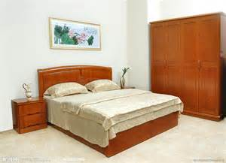
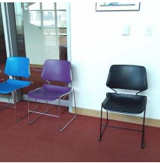
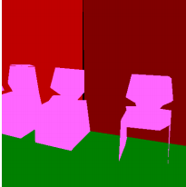
Mathematical Background
Localization: Estimate the position of object
Rectangle Bounding Box (Quite Popular)
Sliding Based: Search the whole image with the fixed bounding box
Regression Based: Regress the coordinate of the bounding box
Pixel-wise Mask (Related to Semantic Image Segmentation)
Input: Image I → Output: Bounding Box/Regions
Rectangle Bounding Box
Region Mask

Slide 9
Mathematical Background
Rectangle Bounding Box
Input: Image → Output: Bounding Box/Regions
Object 1: ($x_{1}$, $y_{1}$, $w_{1}$, $h_{1}$)
Object 2: ($x_{1}$, $y_{2}$, $w_{2}$, $h_{2}$) Object 3: ($x_{1}$, $y_{3}$, $w_{3}$, $h_{3}$)
Object 4: ($x_{4}$, $y_{4}$, $w_{4}$, $h_{4}$)
Input Image
Rectangle Bounding Box

Slide 10
Mathematical Background
Recognition: Identify the object category for the candidate object regions, i.e., image classification.
Input: Bounding Box/Regions → Output: Category label y
Poster
clothes
closet
Poster: ($x_{1}$, $y_{1}$, $w_{1}$, $h_{1}$)
double bed: ($x_{1}$, $y_{2}$, $w_{2}$, $h_{2}$)
Clothes closet: ($x_{1}$, $y_{3}$, $w_{3}$, $h_{3}$)
Bed Closet: ($x_{4}$, $y_{4}$, $w_{4}$, $h_{4}$)
Glass
double bed
Bed Closet

Slide 11
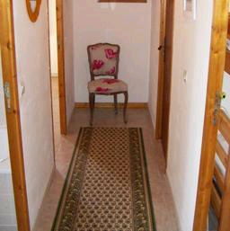
Object Detection Procedure
A toy example for demonstration.
Output the chair candidate estimation
(maximal response = most probable)
Search the input image
This is predicted
to be a chair
Slide from Feifei Li [CS6780: Advanced Machine Learning]

Slide 12
General Pipeline

Slide 13
General Pipeline for Object Detection
Training Procedure
Dataset Collection
Propose Object Location
Feature Representation
Detector
Training
Collect image, user annotation pair (x, y)
Generate candidate object regions
Extract relevant or valuable information from proposed object regions
Learn to recognize/classify the candidate object regions via the user annotation y
Input: Images and the corresponding annotations
Output: Trained object detectors

Slide 14
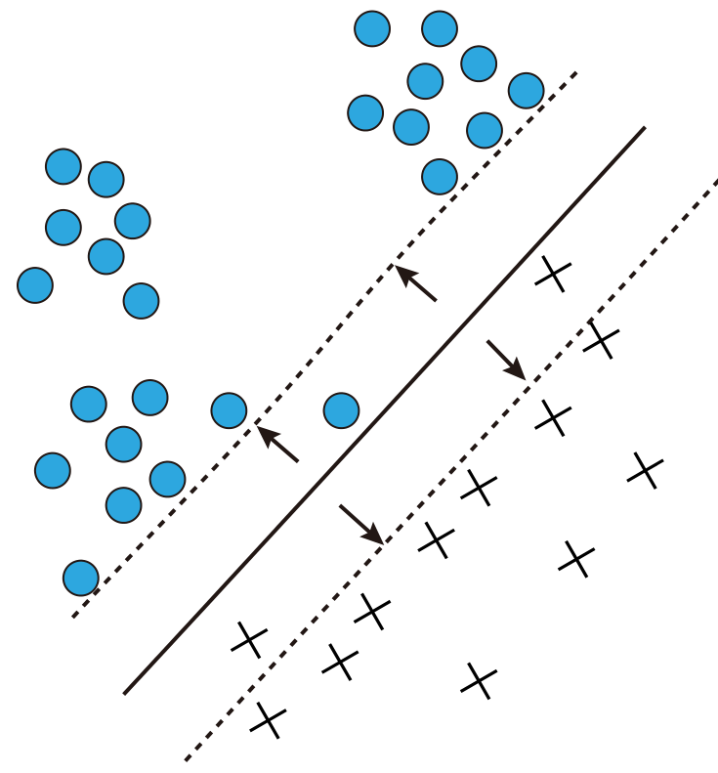
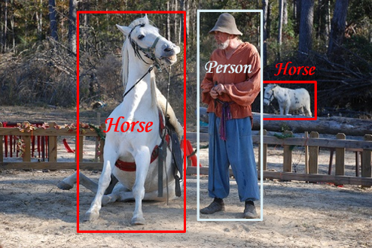
General Pipeline for Object Detection
Testing Phase
Image
Propose Object
Location
Feature Representation
Detector
Prediction
Location & Label
Decision and Classification in the feature space
Bounding Box
Feature Vector
Input: Images
Output: Predicted Object Region and Category Label

Slide 15
Traditional Approaches

Slide 16
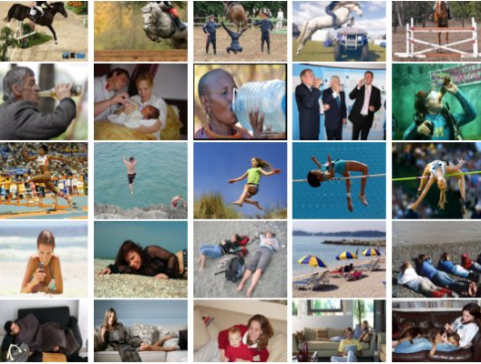
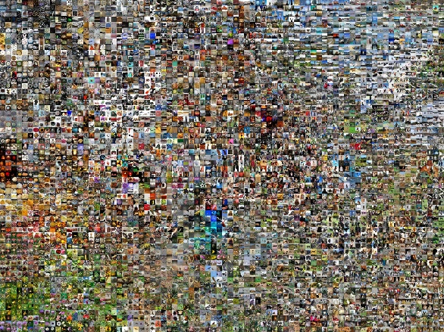
Object Detection Dataset
Dataset Collection
Propose Object Location
Feature Representation
Detection Training
Collect image samples and annotate them with labels.
Popular public image dataset for classification
PASCAL VOC Challenge
10 thousand images
(20 categories)
MS COCO
200 thousand images
(80 categories)
ImageNet
400 thousand Images
200 categories

Slide 17
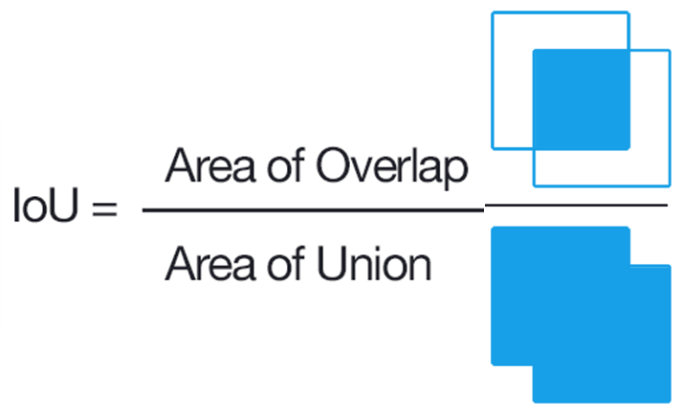
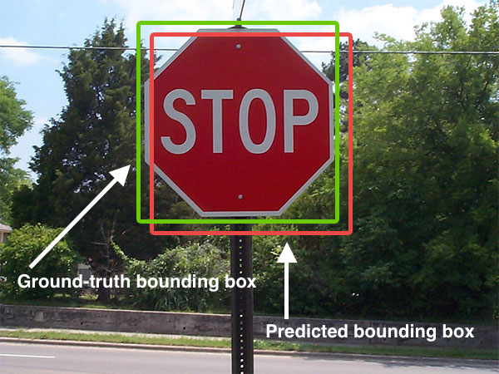
Dataset Evaluation
To evaluate an object detector, we need ground-truth, i.e., hand labeled bounding boxes that specify where the object is.
Evaluation Metric
Intersection of Union (IoU) for the ground-truth and prediction.
Picture from Adrian Rosebrock

Slide 18
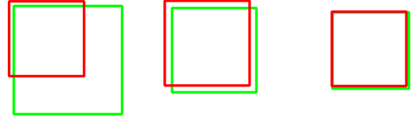
Evaluation Metric
Intersection of Union (IoU): simply a ratio. In most of benchmarks, IoU > 0.5 is normally considered as a “correct” prediction.
IoU: 0.41
IoU: 0.73
IoU: 0.99
Red: ground-truth
Green: prediction
Poor
Correct
Excellent

Slide 19
Evaluation Metric
Correct Detection: A predicted box achieves IoU above 0.5 with respect to the ground-truth box for a certain category
Average Precision: The area under precision-recall curve
Precision =$\frac{N.o correct detection}{N.o all detect objects}$
Recall =$\frac{N.o correct detection}{N.o all ground−truth objects}$
Mean Average Precision (mAP) : Dominantly Used
Calculate the average precision for each category
Take the mean of these average individual-class-precision

Slide 20
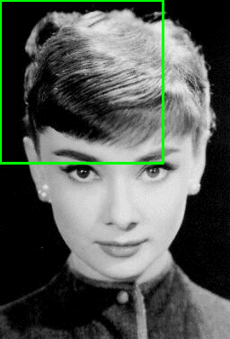
Sliding Window
Dataset Collection
Propose Object
Location
Feature Representation
Detector Training
Sliding Window: Slide a window from left-to-right and top-to-bottom.
Preparing samples for detector training
Positive Sample: the object(s) you want to detect
Negative Sample: the region does not contain the target
Picture from Adrian Rosebrock

Slide 21
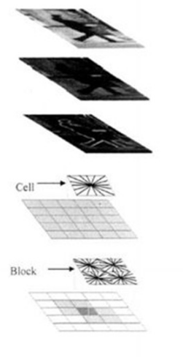
Histogram of Oriented Gradient (HoG)
Dataset Collection
Propose Object Location
Feature Representation
Detector Training
A specific feature representation for object detection
Pictures from Navneet Dalal and Bill Triggs CVPR2005
N. Dalal and B. Triggs, Histograms of Oriented Gradients for Human Detection, CVPR 2005

Slide 22
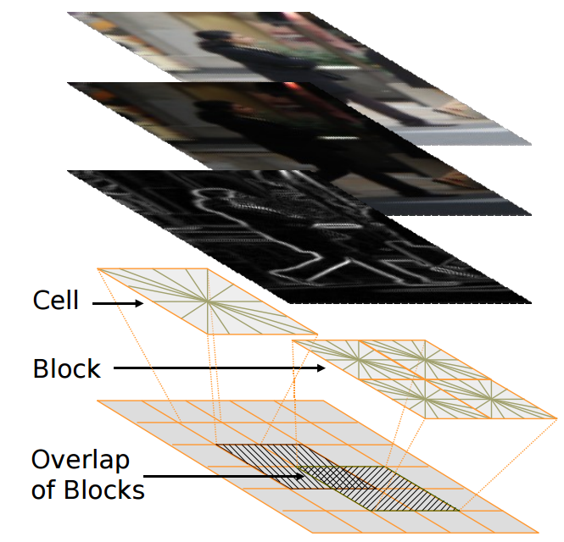
Histogram of Oriented Gradient (HoG)
Pipeline
Feature Extraction
N. Dalal and B. Triggs, Histograms of Oriented Gradients for Human Detection, CVPR 2005.

Slide 23
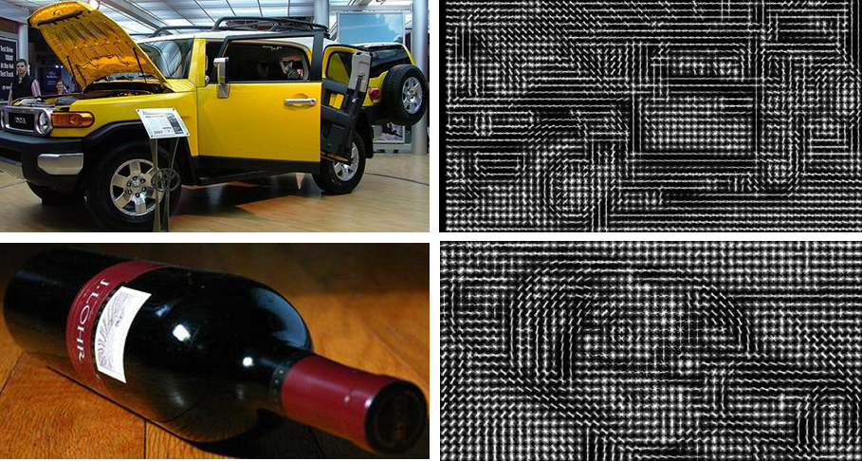
Histogram of Oriented Gradient (HoG)
HoG Feature Extraction Pipeline
Visual Example
C. Vondrick and A. Khosla and H. Pirsiavash and T. Malisiewicz and A. Torralba, HOGgles: Visualizing Object Detection Features, ICCV 2013.

Slide 24
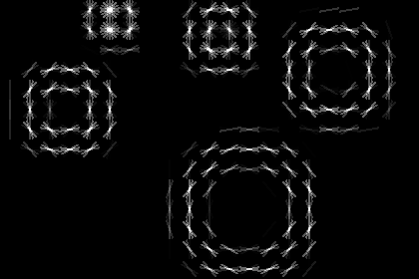
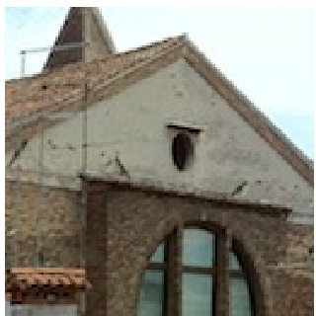
Histogram of Oriented Gradient (HoG)
HoG Parameters
Multiscale
Number of orientations
10x10 cells
20x20 cells
Input image
Num: 3
Num: 4
Num: 5
Num: 9
Num: 21
Picture from vlfeat.org
N. Dalal and B. Triggs, Histograms of Oriented Gradients for Human Detection, CVPR 2005

Slide 25
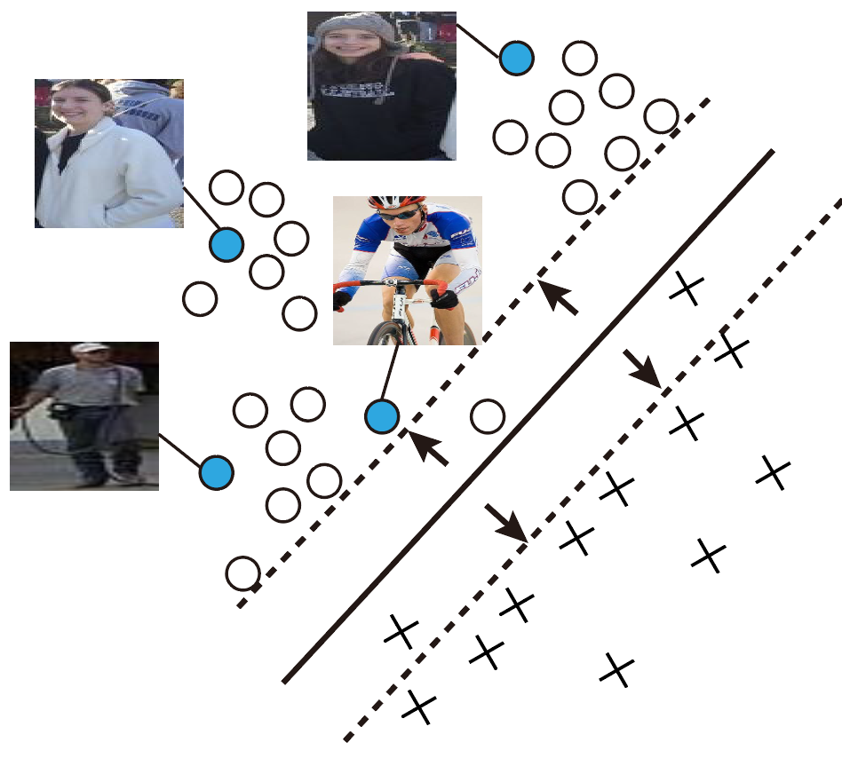
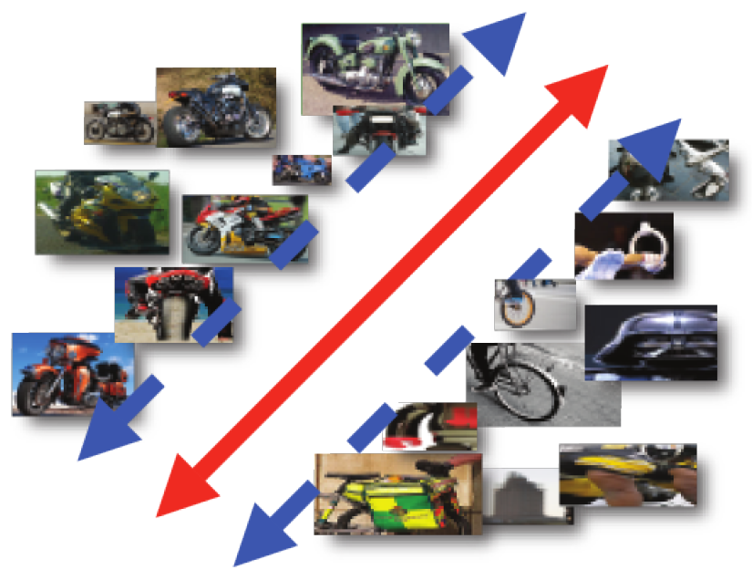
Category SVM Classifier
Dataset Collection
Propose Object
Location
Feature Representation
Detector Training
Train SVM classifier for each object category as the image classification task
Person Classifier
Moto Classifier

Slide 26
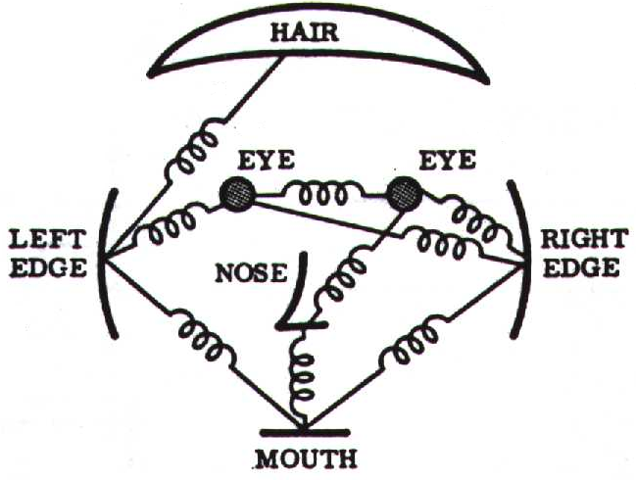
Part-based Modeling
Dataset Collection
Propose Object
Location
Feature Representation
Detector Training
A object (e.g., human face) consists of several parts (e.g., hair, eye, nose and mouth).
Need to model:
Appearance of parts
Relations of parts
Occlusion of parts
Deformable of parts
Figure from [Fischler & Elschlager 73]

Slide 27
Object Part Representation
Each part has an independent appearance term
Each part has several possible locations in image
Part Relations:
Part A is independent
Part B and part C is independent, given location of Part A
Part A
Part B
Part C

Slide 28
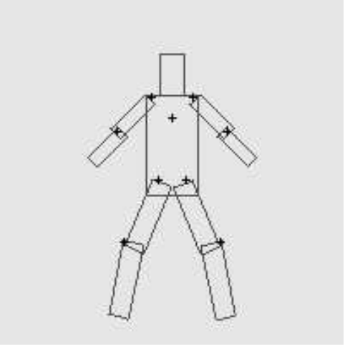
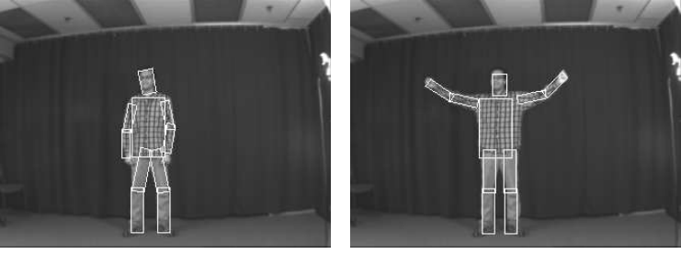
Pictorial Structure Model
An object is represented by parts in a tree-structured deformable configuration.
The appearance of each part is modeled separately
The deformable configuration is represented by spring-like connections between pairs of parts
Connection
P. Felzenszwalb, D. Huttenlocher. Pictorial Structures for Object Recognition. In International Journal of Computer Vision, Vol. 61, No. 1, January 2005

Slide 29
Pictorial Structure Model
The objective of matching a pictorial structure is to minimize the following function.
Head
Neck
L-Shoulder
R-Shoulder
…
Appearance match cost
Deformation cost for connected pairs of parts
P. Felzenszwalb, D. Huttenlocher. Pictorial Structures for Object Recognition. In International Journal of Computer Vision, Vol. 61, No. 1, January 2005
29

Slide 30
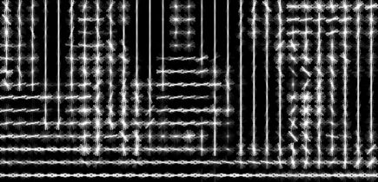
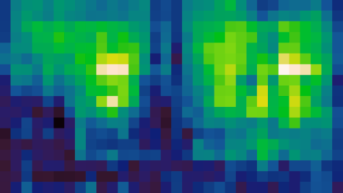
Deformable Part-based Model
Pedestrian detection with HoG
Calculate HoG feature map
Convolve feature map with pedestrian template
Find local maxima of response
HoG Feature Map
Pedestrian
Template
Detected Response Map
N. Dalal and B. Triggs, Histograms of Oriented Gradients for Human Detection, CVPR 2005

Slide 31
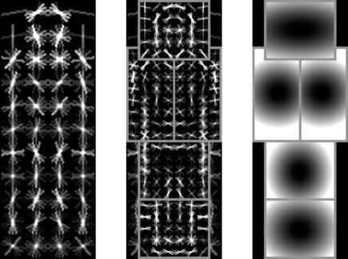
Deformable Part-based Model
Mixture of deformable part model
Each object has global coarse template (root filters) + deformable finer parts (part filters)
Root filters
Part filters
Deformation weights
P. Felzenszwalb, R. Girshick, D. McAllester, D. Ramanan, Object Detection with Discriminatively Trained Part Based Models, PAMI 32(9), 2010

Slide 32
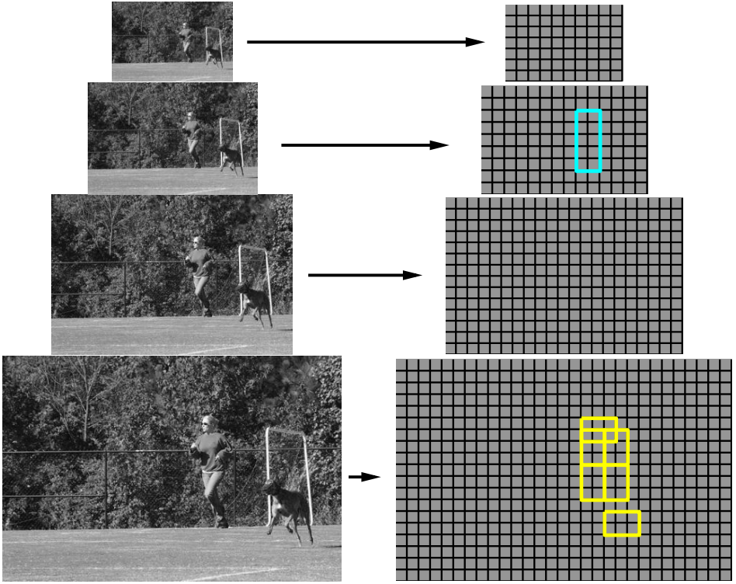
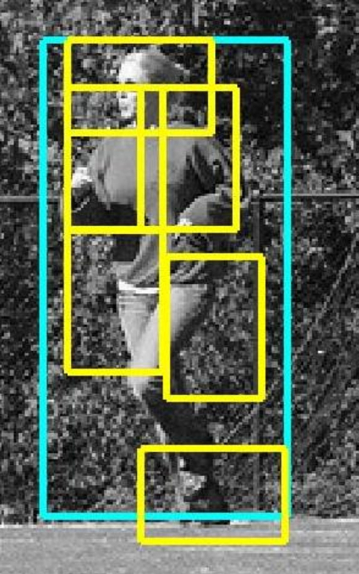
Deformable Part-based Model
HoG feature pyramid and object hypothesis
Location of Root
Location of Parts
Image Pyramid
HoG Feature Pyramid
P. Felzenszwalb, R. Girshick, D. McAllester, D. Ramanan, Object Detection with Discriminatively Trained Part Based Models, PAMI 32(9), 2010

Slide 33
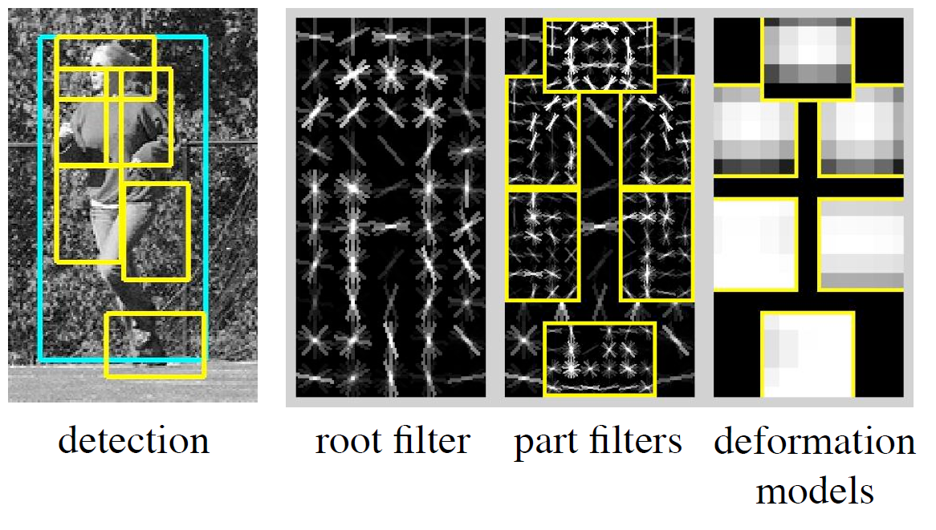
Deformable Part-based Model
Overview
P. Felzenszwalb, R. Girshick, D. McAllester, D. Ramanan, Object Detection with Discriminatively Trained Part Based Models, PAMI 32(9), 2010

Slide 34
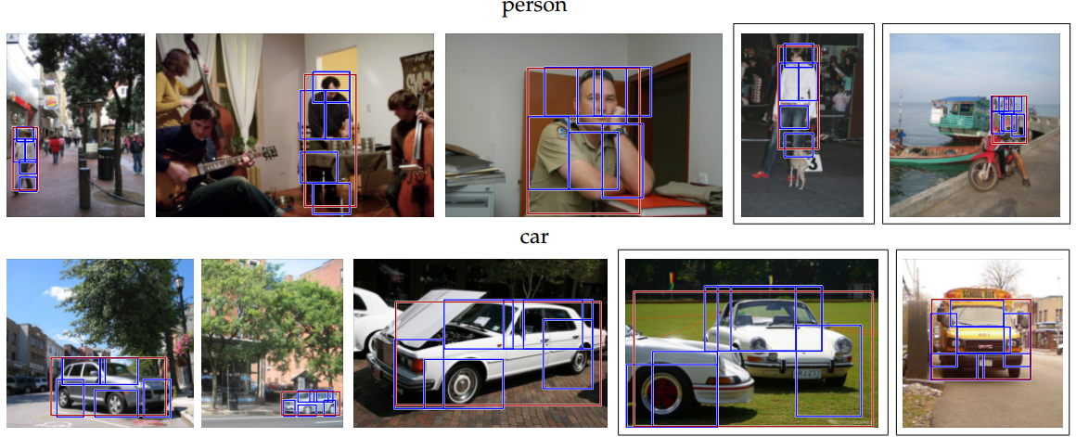
Deformable Part-based Model
Sample Results
P. Felzenszwalb, R. Girshick, D. McAllester, D. Ramanan, Object Detection with Discriminatively Trained Part Based Models, PAMI 32(9), 2010

Slide 35
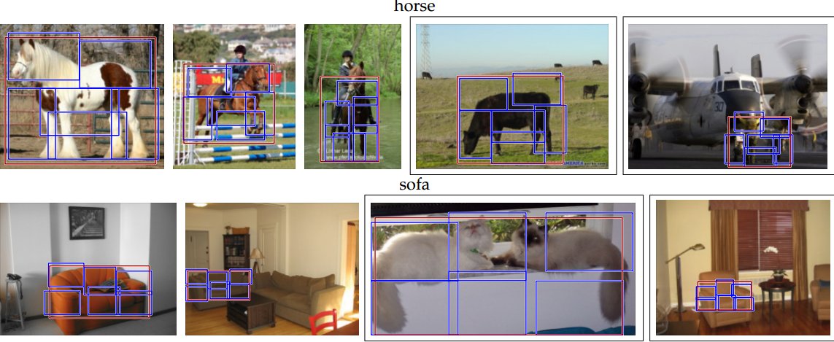
Deformable Part-based Model
Sample Results
P. Felzenszwalb, R. Girshick, D. McAllester, D. Ramanan, Object Detection with Discriminatively Trained Part Based Models, PAMI 32(9), 2010

Slide 36
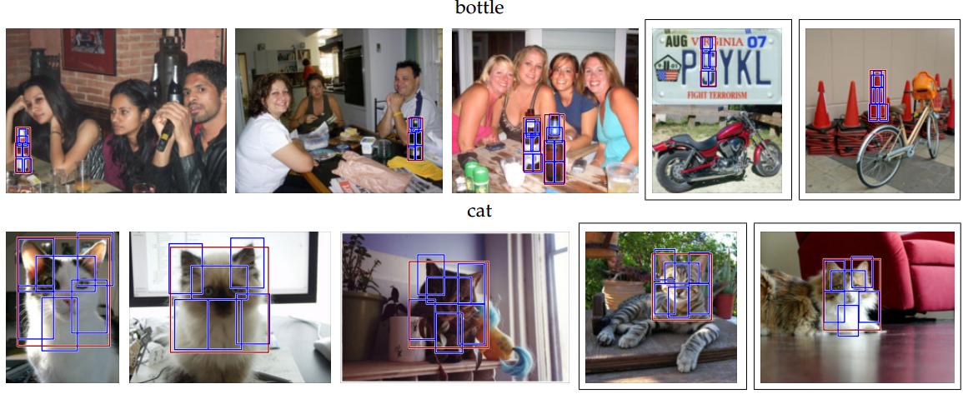
Deformable Part-based Model
Sample Results
P. Felzenszwalb, R. Girshick, D. McAllester, D. Ramanan, Object Detection with Discriminatively Trained Part Based Models, PAMI 32(9), 2010

Slide 37
Deep Learning based Approaches

Slide 38
The History of Deep Learning for Object Detection
The detection accuracy has been increased
from 49.6% mAP to 88.4% mAP in only 3 years
R. Girshick
Wei Liu
Jitendra Malik
R. Girshick
Shaoqing Ren
Christian Szegedy
Kaiming He
R-CNN
2014
49.6% mAP
Fast-rcnn
2015
68.4% mAP
Faster-rcnn
2016
75.9% mAP
SSD
2016
82.2% mAP
R-FCN
2017
88.4% mAP

Slide 39
Deep Learning for Object Detection
Dataset Collection
Propose Object
Location
Feature Representation
Detector Training
Learn feature representation, propose object location and recognition in an end-to-end manner.
Advantages:
Work well under large-scale scenarios
Boost the efficiency of object proposal generation
Achieve much better detection accuracy
Disadvantage
Require large amount of annotations.
Unclear decision making (black box)

Slide 40
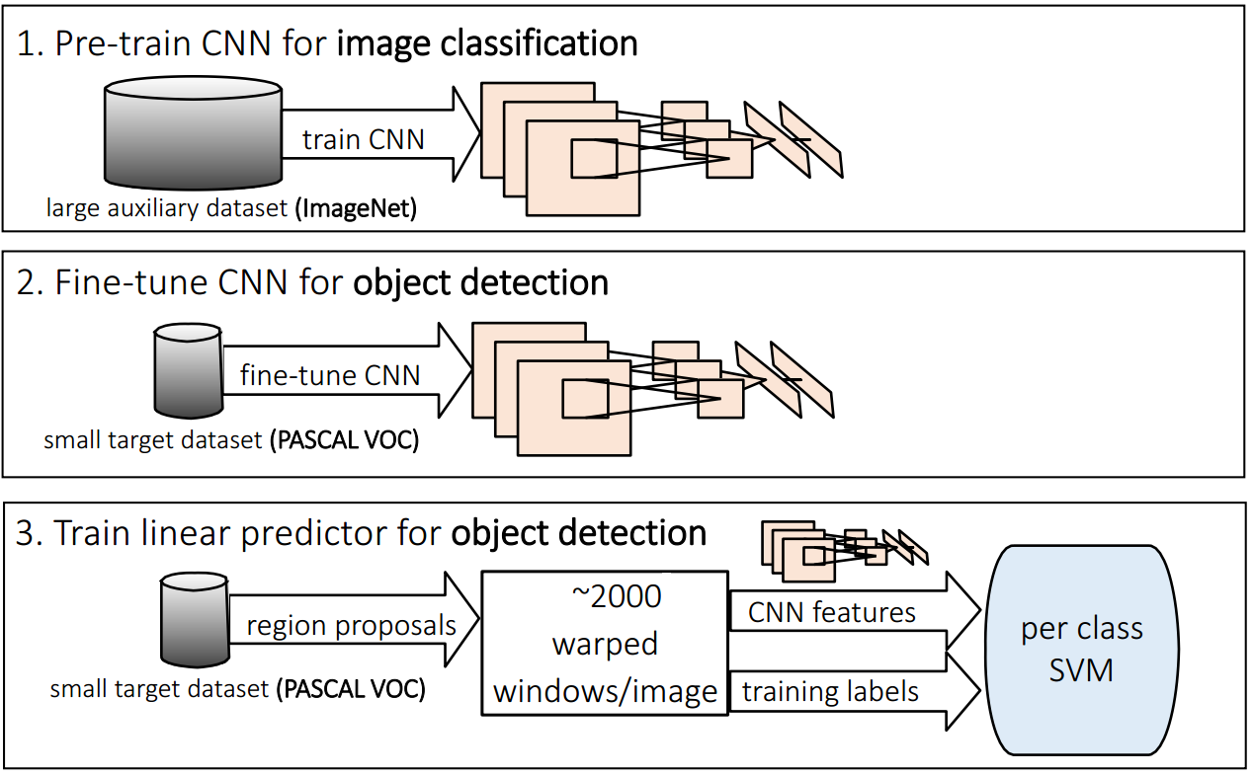
Example: Region with CNN Features
Girshick et al. proposed to convert object detection into region classification, and employ CNNs to extract features.
Figure from Girshick
R. Girshick, J. Donahue, T. Darrell, and J. Malik, “Rich feature hierarchies for accurate object detection and semantic segmentation,” in CVPR, 2014.

Slide 41
Example: Region with CNN Features
Testing Phase:
Step1. Input an image
Step2. Use selective search to obtain ~2k proposals
Step3. Warp each proposal and apply CNN to extract its features
Step4. Adopt class-specified SVM to score each proposal
Step5. Rank the proposals and use NMS to get the bboxes.
Step6. Use class-specified regressors to refine the bboxes’ positions
R. Girshick, J. Donahue, T. Darrell, and J. Malik, “Rich feature hierarchies for accurate object detection and semantic segmentation,” in CVPR, 2014.

Slide 42
Deep Learning for Object Detection
Common Pipeline
Dataset Collection
Network
Design
Network
Finetuning
Collect image and object label pair (x, y)
Design the architecture of neural networks
Optimize the parameters of network
Input: Images and the corresponding annotaions
Output: Trained network parameters

Slide 43
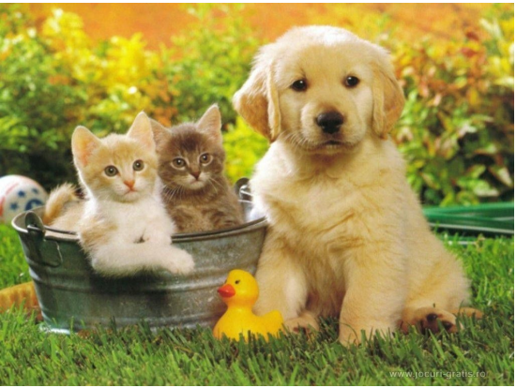
Deep Learning for Object Detection
Dataset Collection
Hard Negative Mining: To handle the imbalance of training samples, we pick out the hard/difficult negative samples which are easy to be misclassified.
Dataset Collection
Network
Design
Network
Finetuning
Hard Negative
Mining
Negative Samples for the dog category
(too many)
Negative Samples for the dog category
(good)

Slide 44
Deep Learning for Object Detection
The Objectives of Network Design
Promote localization performance
Employ additional network layers to estimate object proposal
Promote recognition performance
Leverage new state-of-the art deep neural networks
Promote the whole detection efficiency
Simplify the detection process
Propose lightweight neural networks
Dataset Collection
Network
Design
Network
Finetuning

Slide 45
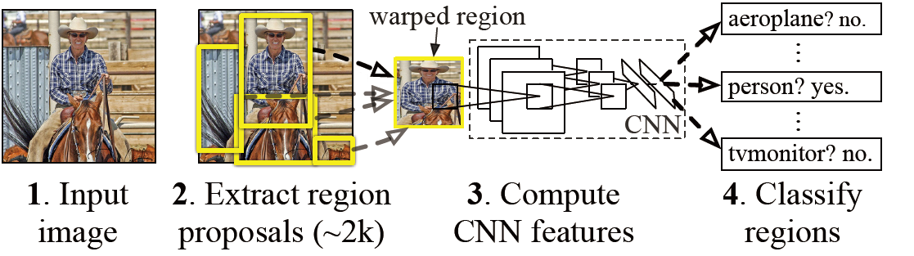
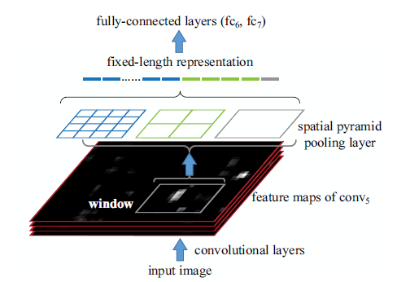
Improve localization
Motivation
FC layer needs a fixed-length input while conv layer can be adapted to arbitrary input size.
Thus SPP layer is a bridge between the conv and FC layer.
Dataset Collection
Network
Design
Network
Finetuning
Example: Spatial Pyramid Pooling Net
Kaiming He, Xiangyu Zhang, Shaoqing Ren, Jian Sun, “Spatial Pyramid Pooling in Deep Convolutional Networks for Visual Recognition,” PAMI, 2015.

Slide 46
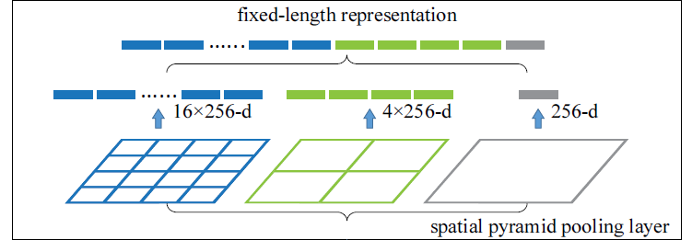
Spatial Pyramid Pooling Net
Improve 1.2% mAP over R-CNN.
filter number
Max pooling
Kaiming He, Xiangyu Zhang, Shaoqing Ren, Jian Sun, “Spatial Pyramid Pooling in Deep Convolutional Networks for Visual Recognition,” PAMI, 2015.

Slide 47
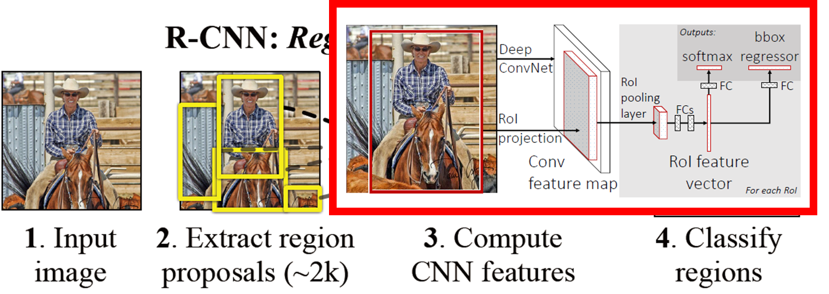
Improve localization
Joint the feature extractor, classifier, regressor together in a unified framework
Dataset Collection
Network
Design
Network
Finetuning
Example: Fast R-CNN
Ross Girshick, Fast R-CNN, ICCV 2015

Slide 48
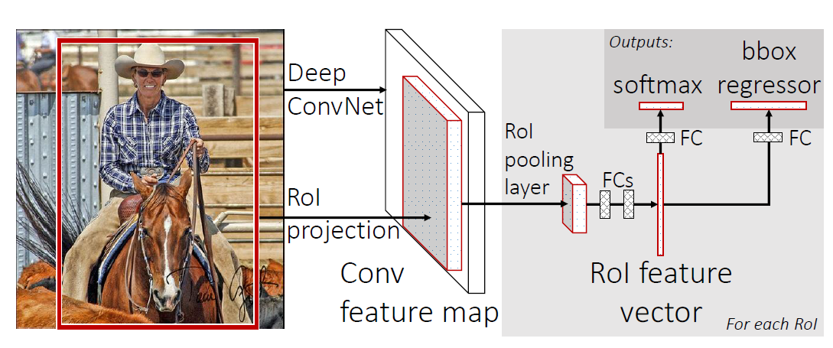
Improve localization
Avoid redundant computation via Region of Interest projection.
Dataset Collection
Network
Design
Network
Finetuning
Example: Fast R-CNN
Ross Girshick, Fast R-CNN, ICCV 2015

Slide 49
Improve localization
Motivation: predicts object positions & their objectness under defined anchor boxes (Region Proposal Networks)
Dataset Collection
Network
Design
Network
Finetuning
Example: Faster R-CNN
Shaoqing Ren, Kaiming He, Ross Girshick, Jian Sun, Faster R-CNN: Towards Real-Time Object Detection with Region Proposal Networks, In NIPS 2015.

Slide 50
Improve localization
Motivation: Address localization problem in a coarse to fine manner
Dataset Collection
Network
Design
Network
Finetuning
Example: Fine Grained Search via Structured SVM
Y. Zhang, K. Sohn, R. Villegas, G. Pan, and H. Lee. Improving object detection with deep convolutional networks via bayesian optimization and structured prediction. In CVPR, 2015.

Slide 51
Improve Recognition
Multi-region
Extracted features are sensitive to inaccurate localizations
Effective. E.g., (i) contributes 1.2% on VOC2007
Dataset Collection
Network
Design
Network
Finetuning
Example: Multi-region & semantic segmentation-aware CNN model
Spyros Gidaris, Nikos Komodakis. Object detection via a multi-region & semantic segmentation-aware CNN model. ICCV 2015.

Slide 52
Semantic Segmentation-Aware CNN Features
Semantic Segmentation-Aware CNN Features
Segmentation cues help object detection
Activation-maps: class-specific foreground Segmentation
Fully Conv Nets and Weakly Supervised Training
Channel reduction (4096 converged, 512 for further fine-tuning)
Spyros Gidaris, Nikos Komodakis. Object detection via a multi-region & semantic segmentation-aware CNN model. ICCV 2015.

Slide 53
Semantic Segmentation-Aware CNN Features
The whole architecture
Spyros Gidaris, Nikos Komodakis. Object detection via a multi-region & semantic segmentation-aware CNN model. ICCV 2015.

Slide 54
Improve Recognition
Motivation
Classify and locate objects accurately and efficiently, without using bounding box annotations.
Approach object classification problem by zooming onto promising image boxes.
Dataset Collection
Network
Design
Network
Finetuning
Example: ProNet
Chen Sun, Manohar Paluri, Ronan Collobert, Ram Nevatia, and Lubomir Bourdev. ProNet: Learning to Propose Object-specific Boxes for Cascaded Neural Networks. In CVPR 2016.

Slide 55
ProNet
Motivation
Chen Sun, Manohar Paluri, Ronan Collobert, Ram Nevatia, and Lubomir Bourdev. ProNet: Learning to Propose Object-specific Boxes for Cascaded Neural Networks. In CVPR 2016.

Slide 56
ProNet
Methodology
It first applies a multi-scale fully-convolutional network to select boxes that are likely to contain objects.
It then feeds the selected boxes to CNNs trained on harder instances for verification.
Chen Sun, Manohar Paluri, Ronan Collobert, Ram Nevatia, and Lubomir Bourdev. ProNet: Learning to Propose Object-specific Boxes for Cascaded Neural Networks. In CVPR 2016.

Slide 57
Improve Recognition
Motivation
Object rotation, within-class variability and between-class similarity
Dataset Collection
Network
Design
Network
Finetuning
Example: RIFD-CNN
Gong Cheng, Peicheng Zhou, Junwei Han. RIFD-CNN: Rotation-Invariant and Fisher Discriminative Convolutional Neural Networks for Object Detection. In CVPR 2016.

Slide 58
RIFD-CNN
Methodology
learn a rotation-invariant and Fisher discriminative CNN
Gong Cheng, Peicheng Zhou, Junwei Han. RIFD-CNN: Rotation-Invariant and Fisher Discriminative Convolutional Neural Networks for Object Detection. In CVPR 2016.

Slide 59
Improve Efficiency
Motivation
Model object detection as a regression like human
Dataset Collection
Network
Design
Network
Finetuning
Example: YOLO: Unified, Real-Time Object Detection
Joseph Redmon, Santosh Divvala, Ross Girshick, Ali Farhadi, You Only Look Once: Unified, Real-Time Object Detection, In CVPR 2016.

Slide 60
YOLO: Unified, Real-Time Object Detection
Methodology
Leaky rectified linear activation on 24 convolutional and 2 fully connected layers:
Joseph Redmon, Santosh Divvala, Ross Girshick, Ali Farhadi, You Only Look Once: Unified, Real-Time Object Detection, In CVPR 2016.

Slide 61
Improve Efficiency
Motivation
Discretizes the output space of bounding boxes into a set of default boxes over different aspect ratios and scales per feature map location
Dataset Collection
Network
Design
Network
Finetuning
Example:SSD:Single Shot MultiBox Detector
Wei Liu et al. SSD: Single Shot MultiBox Detector. In ECCV 2016.

Slide 62
SSD (better than YOLO)
Methodology
adds several specific feature layers to the end of a base network.
Wei Liu et al. SSD: Single Shot MultiBox Detector. In ECCV 2016.

Slide 63
Improve Efficiency
Motivation
Accurate region proposal generation and joint object detection
Dataset Collection
Network
Design
Network
Finetuning
Example: HyperNet
Tao Kong, Anbang Yao, Yurong Chen, and Fuchun Sun. HyperNet: Towards Accurate Region Proposal Generation and Joint Object Detection. In CVPR 2016.

Slide 64
HyperNet
Methodology
Move the 3×3×4 convolutional layer to the front of ROI pooling to accelerate test speed.
Tao Kong, Anbang Yao, Yurong Chen, and Fuchun Sun. HyperNet: Towards Accurate Region Proposal Generation and Joint Object Detection. In CVPR 2016.

Slide 65
Improve Efficiency
Motivation
Improve time efficiency: Fast/Faster R-CNN apply a costly per-region subnetwork hundreds of times.
Dataset Collection
Network
Design
Network
Finetuning
Example: R-FCN
Efficient region-based fully CNN
Jifeng Dai, Yi Li, Kaiming He, and Jian Sun. R-FCN: Object Detection via Region-based Fully Convolutional Networks In Conference on Neural Information Processing Systems (NIPS), 2016

Slide 66
R-FCN
Methodology
All learnable weight layers are convolutional and are computed on the entire image
The per-RoI computational cost is negligible
Jifeng Dai, Yi Li, Kaiming He, and Jian Sun. R-FCN: Object Detection via Region-based Fully Convolutional Networks In Conference on Neural Information Processing Systems (NIPS), 2016

Slide 67
R-FCN
Methodology
Position-sensitive pooling
Jifeng Dai, Yi Li, Kaiming He, and Jian Sun. R-FCN: Object Detection via Region-based Fully Convolutional Networks In Conference on Neural Information Processing Systems (NIPS), 2016

Slide 68
Deep Learning for Object Detection
Dataset Collection
Network
Design
Network
Finetuning
Network Finetuning
Optimization Objective: Classification + Localization
Optimization Methods: The network parameters are updated/fine-tuned to minimize the classification and localization loss via tochastic gradient descent (SGD), Momentum,, Adagrad, Adadelta, RMSprop.
Classification Softmax Loss
Regression Loss

Slide 69
Deep Learning for Object Detection
Dataset Collection
Network
Design
Network
Finetuning
Faster-RCNN Finetuning
(4 Objective Optimization Loss)
Bounding-box Regression Loss
Category Classification Loss
Proposal Classification Loss
Proposal Bounding-box
Regression Loss
Figure from Shaoqing Ren

Slide 70
Practice Tutorial
Selected Dataset: grocery dataset*
Challenging: unbalance, large deformations
Dataset is provided by Microsoft Azure (https://github.com/Azure)

Slide 71
Practice Tutorial
Used Deep Learning Toolbox: CNTK
Flexible architecture
General to a desktop and server with a single API
Easy to learn: Implemented in Python
More Details: https://github.com/Microsoft/CNTK
Work well on Windows Operation System

Slide 72
Practice Tutorial
Install CNTK
Run the install script
Wait for a couple of hours

Slide 73
Practice Tutorial
Activate CNTK
Verify the setup for some demo
Output

Slide 74
Practice Tutorial
Folder Structure of Tutorial Code

Slide 75
Practice Tutorial
Detect Object by Using CNTK
Obtain the PREREQUISITS
STEP 1: Computing Region of Interests
STEP 2: Computing CNTK inputs
STEP 3: Running CNTK
STEP 4: Classifier training
STEP 5: Evaluation and visualization

Slide 76
Practice Tutorial
Detect Object by Using CNTK
STEP 1: Computing Region Proposals
Running the script: 1_computeRois.py

Slide 77
Practice Tutorial
Detect Object by Using CNTK
STEP 2: Computing CNTK inputs
Running the script: 2_cntkGenerateInputs.py
Prepared Input Structure

Slide 78
Practice Tutorial
Detect Object by Using CNTK
STEP 3 and 4: Perform training
Running the script: 3_runCntk.py and 4_trainSvm.py
Ground-truth
Predictions
during the training

Slide 79
Practice Tutorial
Detect Object by Using CNTK
STEP 5: Perform evaluation and visualization
Running the script: 5_evaluateResults.py 5_visualizeResults.py

Slide 80
Unsolved Problems

Slide 81
Semi-supervised Object Detection
Problem Definition: Make use of unlabeled images
Methodology: Visual and Semantic similarity-based knowledge transfer
Yuxing Tang, Josiah Wang, Boyang Gao, Emmanuel Dellandréa. Large Scale Semi-supervised Object Detection using Visual and Semantic Knowledge Transfer. In CVPR 2016.

Slide 82
Weakly-supervised Object Detection
Problem Definition: leverage weakly-labeled videos/images
Methodology: Transfer tracked object boxes from weakly-labeled videos to weakly-labeled images to automatically generate pseudo ground-truth boxes
Krishna Kumar Singh, Fanyi Xiao, and Yong Jae Lee. Track and Transfer: Watching Videos to Simulate Strong Human Supervision for Weakly-Supervised Object Detection. In CVPR 2016.

Slide 83
3D Object Detection
Problem Definition: detect 3D objects, which are manually created/annotated according to a natural image.
3D object need to detect
Natural Image
Annotation Tool
Yu Xiang, Roozbeh Mottaghi, and Silvio Savarese. Beyond PASCAL: A Benchmark for 3D Object Detection in the Wild. In CVPR 2016.

Slide 84
3D Object Detection
Some Examples
The read points are 3D landmarks for further evaluation
Evaluation Metric
Reconstructed 3D landmark
Yu Xiang, Roozbeh Mottaghi, and Silvio Savarese. Beyond PASCAL: A Benchmark for 3D Object Detection in the Wild. In CVPR 2016.

Slide 86
Reference materials
Books
Deep Learning
Neural Network and Deep Learning
Video courses
CS231n: Convolutional Neural Networks for Visual Recognition (Stanford)
Machine Learning (Oxford)
Github
Theano, Tensorflow, Keras, MXNet, Caffe

