Slide 1
Advanced Topics in Visual Computing
Deep Learning for
General Image Classification

Slide 2
Outline
Problem Definition
General Pipeline
Traditional Approaches
Deep Learning based Approaches
Unsolved Problems

Slide 3
Problem Definition

Slide 4
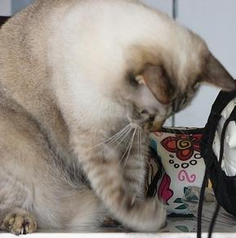
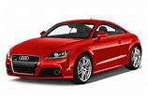
What is Image Classification?
Image Classification: To categorize a digital image according to its main visual content/object.
Sheep
Person
Cat
Car

Slide 5
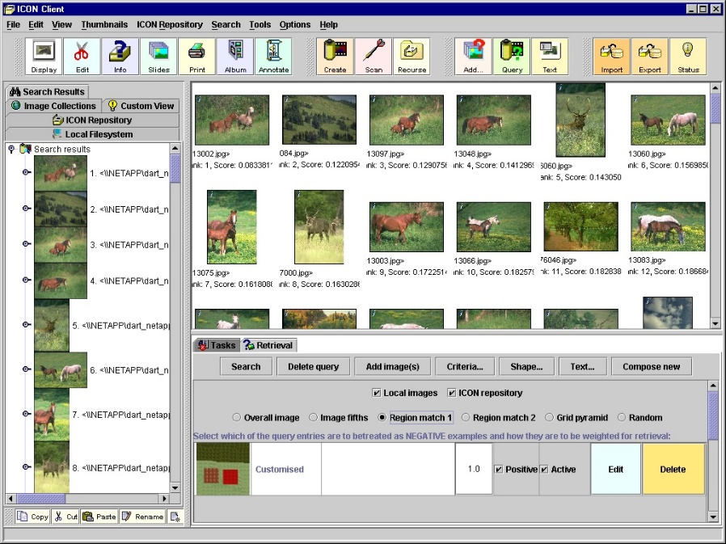
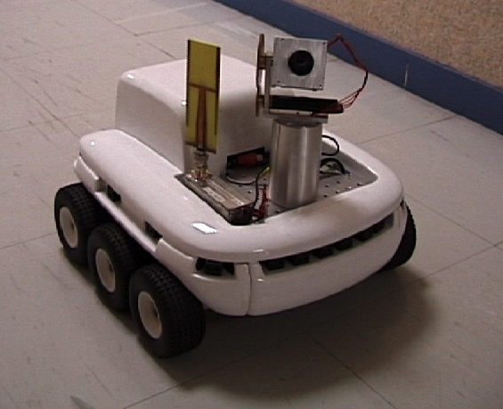
Application Background
Applications: Image Retrieval, Robot Navigation and Cancer Recognition (Medical) etc.
Content based Image Retrieval
Robot Navigation

Slide 6
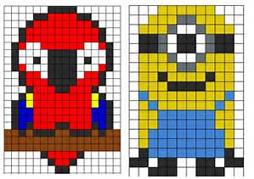
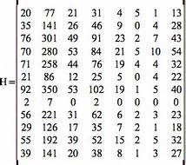
Mathematical Background
To help computer classify/recognize an image, one question needs to be considered:
How to associate image x with its corresponding label y ?
Input: Image x → Output: Category label y
Dog | 1
Bird | 2
Cat | 3
Cow | 4
… | …
Digital images can be denoted as math matrix.
Category labels can be denoted as numbers.

Slide 7
Mathematical Background
The image classification problem is transformed into designing the function F, which can map x into y, i.e.,
y = F(x)
However, x is high dimensional (e.g., an 300 * 400 RGB color image has 360000 (300 * 400 * 3) items), it is quite difficult to directly design F.
To address this issue, we introduce
Feature Extraction
Image Representation
Classifier

Slide 8
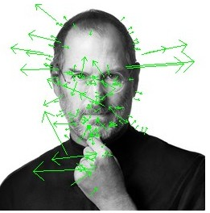
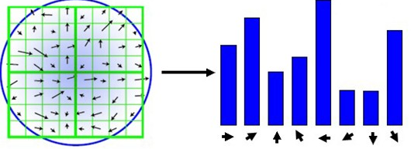
Feature Extraction
Extract relevant or valuable information (e.g., points or regions) from an image to describe its visual content.
SIFT Descriptor
Detect SIFT points with orientation

Slide 9
Image Representation
Generate the image representation (feature vector) by modeling object category inside image.
Feature Vector
Feature Descriptor
Spatial Histogram

Slide 10
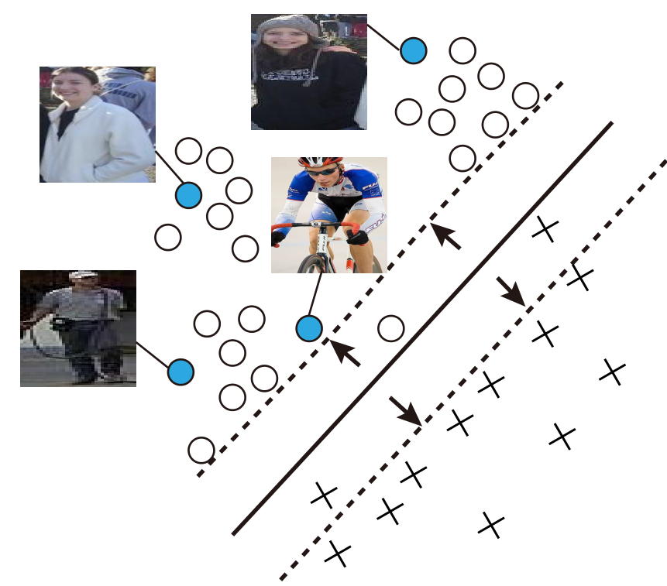
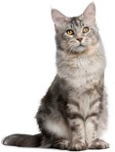
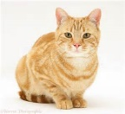
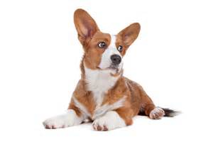
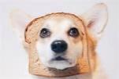
Classifier
Divide feature space into decision regions separated by decision boundaries.
Cat
Person
decision
boundary
decision boundary
Dog
decision boundary
e.g., Support Vector Machine Classifier
e.g., K Nearest Neighbor Classifier

Slide 11
General Pipeline

Slide 12
General Pipeline for Image Classification
Training Procedure
Dataset Collection
Feature Extraction
Image Representation
Classifier Training
Collect image and object label pair (x, y)
Extract relevant or valuable information from the image x
Generate image representation by modeling the object inside image x
Learn to predict the object label with the given feature vector
Input: Images and the corresponding labels
Output: Trained classifiers

Slide 13
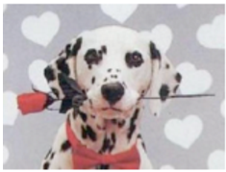
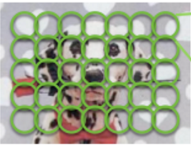
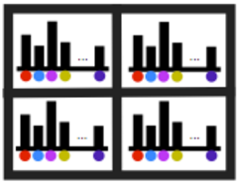
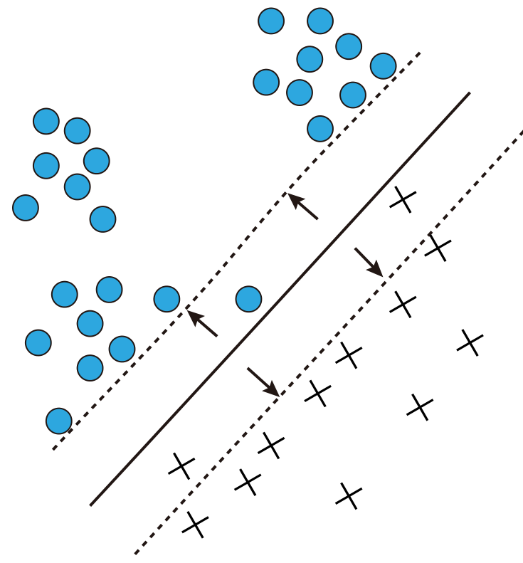
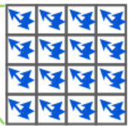
General Pipeline for Image Classification
Testing Phase
Image
Feature Extraction
Image Representation
Classifier
Prediction
Label
Dog
Spatial Histogram
Feature
Vector
Decision and Classification in the feature space
Dense SIFT Feature
Input: Images
Output: Predicted labels

Slide 14
Traditional Approaches

Slide 15
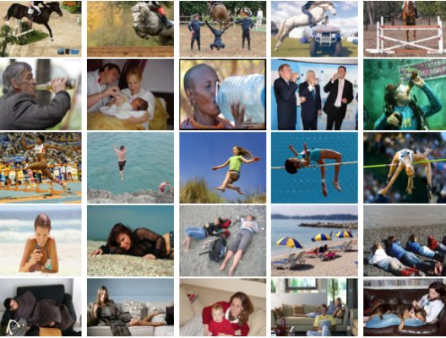
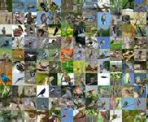
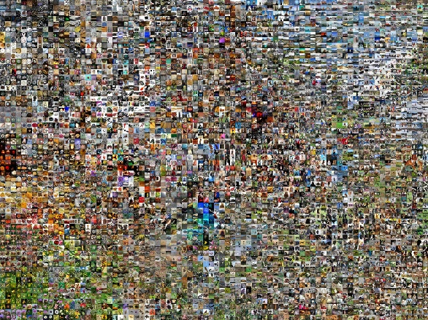
Image Classification Dataset
Dataset Collection
Feature Extraction
Image Representation
Classifier Training
Collect image samples and annotate them with labels.
Popular public image dataset for classification
PASCAL VOC Challenge
10 thousand images
(20 categories)
Caltech
30 thousand images
(256 categories)
ImageNet
1.2 million Images
1000 categories

Slide 16
Dataset Evaluation
To evaluate an approach, we will split it into three-fold:
Training set: A set of samples used for learning, which is to tune/fit the parameters of the approach.
Test set: A set of examples used only to assess/test the performance.
Evaluation Metric
Average Accuracy: The percentage of correctly classified images over the total image number. (Most Popular)
Top-N Accuracy: The probability of the N estimated labels contains the correct label.

Slide 17
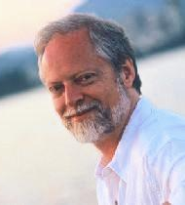
Scale-Invariant Feature Transform (SIFT)
Dataset Collection
Feature Extraction
Image Representation
Classifier Training
Proposed by David Lowe in ICCV1999,
refined in IJCV 2004
Objective
To detect and describe local regions /features in images.
Invariant to scale, rotation and illumination change
Robust to addition of noise
Highly distinctive for discrimination for classification
David Lowe
Professor in UBC
D. G. Lowe, "Object recognition from local scale-invariant features," In ICCV, pp. 1150-1157 vol.2,1999.
D. G. Lowe, "Distinctive Image Features from Scale-Invariant Keypoints", In IJCV 2004.

Slide 18
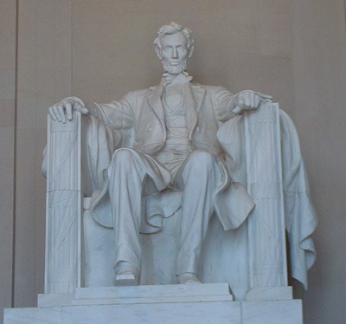
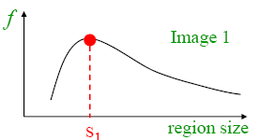
Scale-Invariant Feature Transform (SIFT)
SIFT Detector: Special Image Regions
Local response maxima in both different position and scale
Make image region scale invariant
D. G. Lowe, "Distinctive Image Features from Scale-Invariant Keypoints ", In IJCV 2004.

Slide 19
Scale-Invariant Feature Transform (SIFT)
SIFT Descriptor:
Rotate patch according to its dominant gradient orientation
Make descriptor rotation invariant
SIFT Descriptor
D. G. Lowe, "Distinctive Image Features from Scale-Invariant Keypoints", In IJCV 2004.

Slide 20
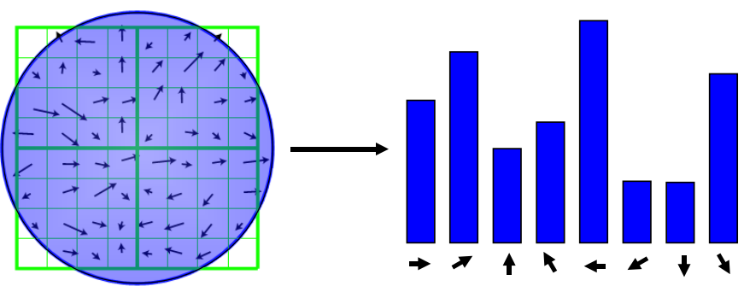
Scale-Invariant Feature Transform (SIFT)
SIFT Descriptor:
Use normalized histograms of orientations to generate SIFT features
Reduce the effects of illumination change
Frequency
Normalization
Orientations
Feature Vector
D. G. Lowe, "Distinctive Image Features from Scale-Invariant Keypoints", In IJCV 2004.

Slide 21
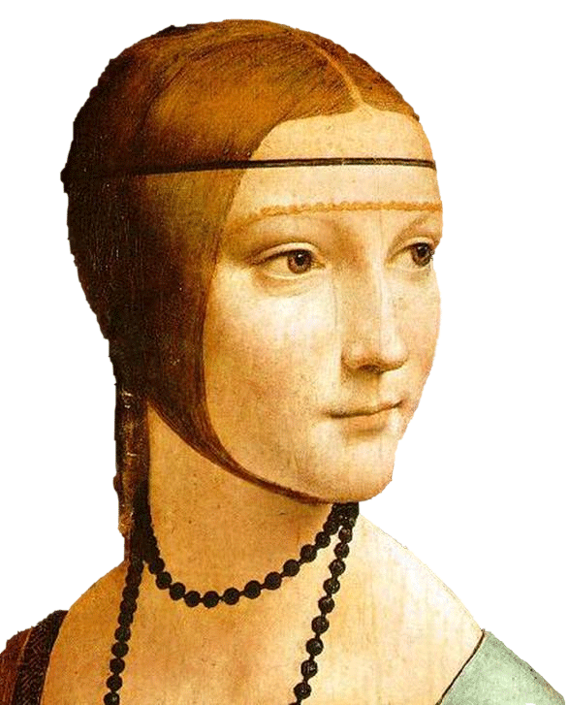
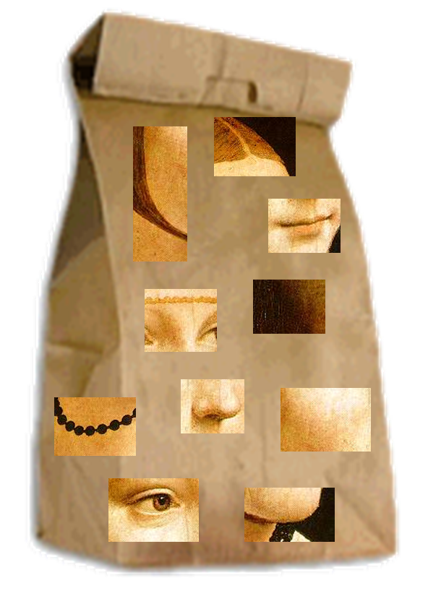
Bag of Words/Features
Dataset Collection
Feature Extraction
Image Representation
Classifier Training
Motivation
An object can be represented by a composition of local image patches/regions.
“word” is used to denote the local image region.
=
A visual “word”
L. Fei-Fei; R. Fergus & A. Torralba. "Recognizing and Learning Object Categories, CVPR 2007 short course”

Slide 22
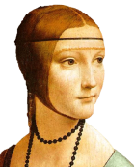
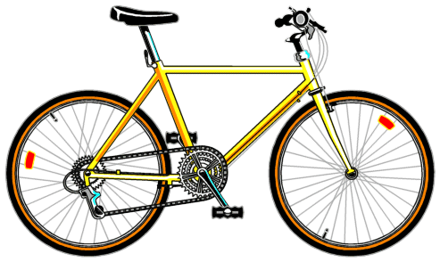
Bag of Words/Features
Motivation
Objects belonged to different categories have different frequencies of specific visual words.
frequency
L. Fei-Fei; R. Fergus & A. Torralba. "Recognizing and Learning Object Categories, CVPR 2007 short course”

Slide 23
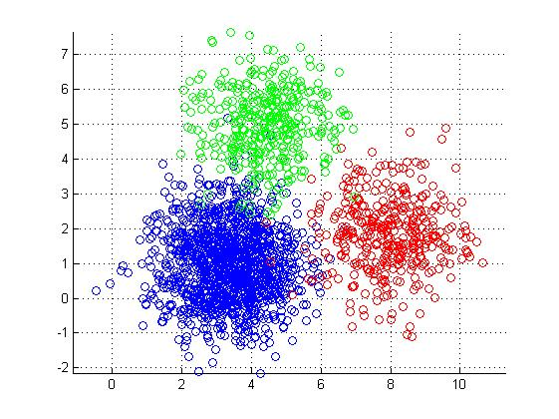
Bag of Words/Features
Methodology
Vector Quantization: Obtain the codebook of visual words by clustering the extracted features.
Clustering
Feature Extraction
The cluster center
represents the visual word
L. Fei-Fei; R. Fergus & A. Torralba. "Recognizing and Learning Object Categories, CVPR 2007 short course”

Slide 24
Bag of Words/Features
Methodology
Represent images by frequencies of visual words (bag-of-words).
Learn a classifier assigning bag-of-words representations of images to different classes.
Violin
Person
frequency
Bike
L. Fei-Fei; R. Fergus & A. Torralba. "Recognizing and Learning Object Categories, CVPR 2007 short course”

Slide 25
Bag of Words/Features
Drawback: The important spatial/location information of visual words is ignored.
Three different images have equal frequencies of visual words.
frequency
frequency
frequency
L. Fei-Fei; R. Fergus & A. Torralba. "Recognizing and Learning Object Categories, CVPR 2007 short course”

Slide 26
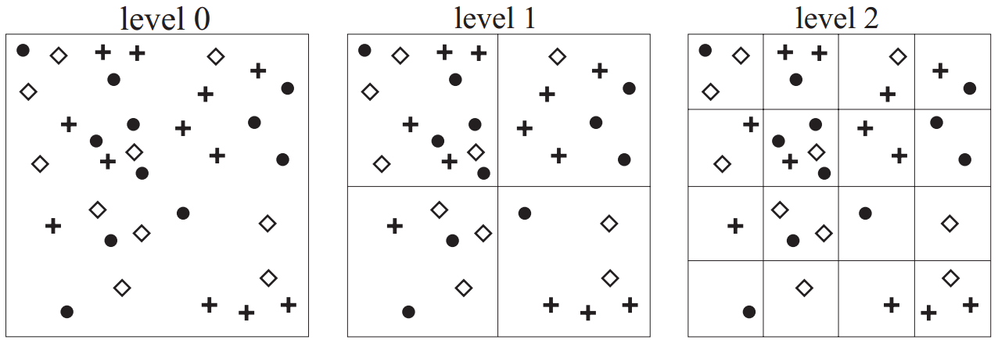
Beyond Bags of Features: Spatial Pyramid Matching
Dataset Collection
Feature Extraction
Image Representation
Classifier Training
Motivation
Partitioning the image into increasing sub-regions
Computing histograms inside each sub-region
Three level pyramid
Spatial histogram
S. Lazebnik, C. Schmid, J. Ponce. "Beyond Bags of Features: Spatial Pyramid Matching for Recognizing Natural Scene Categories”, In CVPR 2006.

Slide 27
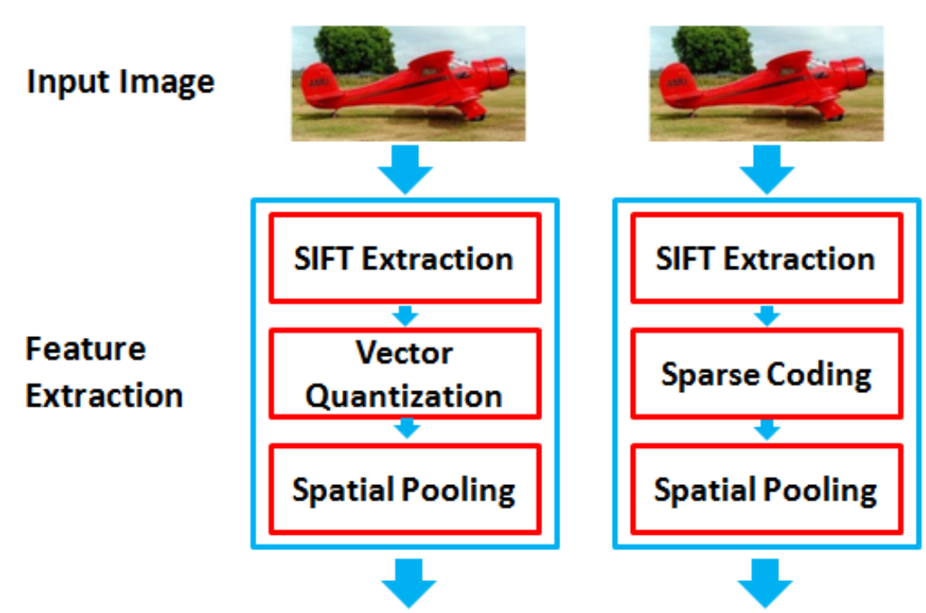
Sparse Coding Spatial Pyramid Matching
Dataset Collection
Feature Extraction
Image Representation
Classifier Training
Motivation
Improve spatial pyramid matching by replacing vector quantization with sparse coding.
Classifier
Jianchao Yang, Kai Yu, Yihong Gong, Thomas Huang. Linear Spatial Pyramid Matching using Sparse Coding for Image Classification. In CVPR 2009.

Slide 28
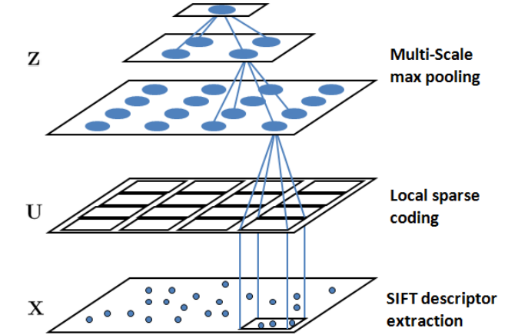
Sparse Coding Spatial Pyramid Matching
Methodology
Encoding SIFT from vector quantization to sparse coding, i.e., overcomplete codebook V is automatically off-line learned.
The feature vector is pooled across different spatial locations over different spatial scales.
X is the extracted SIFT features,
U is the result of applying sparse coding; Z is the max-pooled representation over U for X.
Jianchao Yang, Kai Yu, Yihong Gong, Thomas Huang. Linear Spatial Pyramid Matching using Sparse Coding for Image Classification. In CVPR 2009.

Slide 29
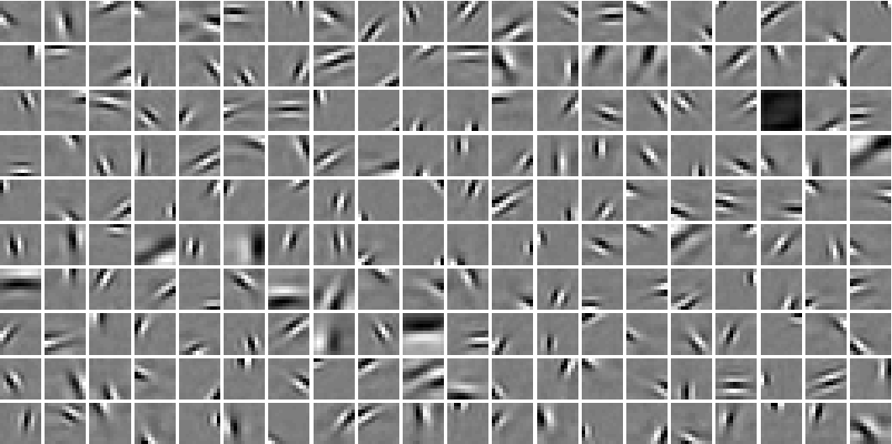
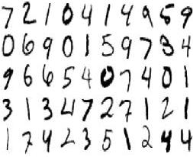
Sparse Coding Spatial Pyramid Matching
Methodology
Visualizing the automatically learned codebook
The learned codebook from Handwritten Digit Dataset
Jianchao Yang, Kai Yu, Yihong Gong, Thomas Huang. Linear Spatial Pyramid Matching using Sparse Coding for Image Classification. In CVPR 2009.

Slide 30
K Nearest Neighbors Classifier
Dataset Collection
Feature Extraction
Image Representation
Classifier Training
Motivation
Predict a sample’s label according to its nearest neighbors who have labels in the feature space.
Car
Cat
Dog
has (k=1) neighbor, which is labeled as cat. Hence, this sample is predicted as cat.
Altman, N. S. (1992). "An introduction to kernel and nearest-neighbor nonparametric regression". In The American Statistician. 46 (3): 175–185.

Slide 31
K Nearest Neighbors Classifier
Motivation
Predict a sample’s label according to its nearest neighbors who have labels in the feature space.
Car
Cat
Dog
has (k=4) neighbors. Since dog has two votes, car and cat all has one. Hence, this sample is predicted as dog.
Altman, N. S. (1992). "An introduction to kernel and nearest-neighbor nonparametric regression". The American Statistician. 46 (3): 175–185.

Slide 32
K Nearest Neighbors Classifier
Drawback: How many neighbors should we count?
A small neighborhood → large variance → unreliable estimation
A large neighborhood → large bias → inaccurate estimation
Altman, N. S. (1992). "An introduction to kernel and nearest-neighbor nonparametric regression". The American Statistician. 46 (3): 175–185.

Slide 33
Softmax Classifier
Dataset Collection
Feature Extraction
Image Representation
Classifier Training
Motivation
Estimate category label y for the input sample x according the conditional distribution P(y | x).
Assume only two categories y = 0 and y = 1 and the model parameter w. Then, the classifier is denoted as P(y | x; w).
Note that we have p(y = 1 | x; w) + p(y = 0 | x; w) = 1
Greene, William H. Econometric Analysis (Seventh ed.). Boston: Pearson Education. pp. 803–806, 2012.

Slide 34
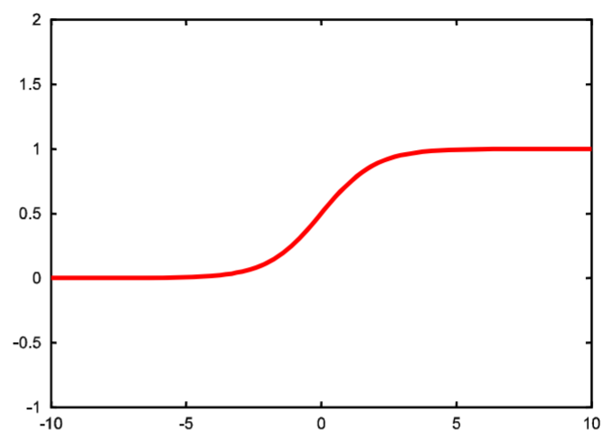
Softmax Classifier
Logistic (Sigmoid) Function* g($x$, $w$)
A linear function ranges from [$−∞,+∞$].
Transform the range to [0, 1] to be a probability.
g($x$, $w$) = $\frac{1}{1+exp⁡(−w∗x)}$
$$w∗x$$
*Walker, SH; Duncan, DB. "Estimation of the probability of an event as a function of several independent variables". Biometrika. 54: 167–178, 1967.

Slide 35
Softmax Classifier
Softmax Classifier: The generalization of Logistic regression classifier to multiple classes.
Input: Feature vector of images $x$
Output: Normalized class probabilities.
Training: Maximize the log-probability of the correct category label
max log P(y | $x;$ $w$)
P(y | $x;$ $w$) = $\frac{exp⁡(w_{y}∗x)}{\sum_{k}{exp⁡(w_{k}∗x)}}$

Slide 36
Softmax Classifier
Information theory view
The cross-entropy between a “true” distribution $p$ and an estimated distribution $q$ is defined as
$H(p,q)$=$−\sum_{x}{p\left(x\right)\log{q(x)}}$
Goal: Minimize the $H\left(p,q\right)$
$p$ and $q$ are almost equivalent.
$q$ has all probability mass on the correct category labels.
Andrej Karpathy, CS231n Convolution Neural Networks for Visual Recogntion.

Slide 37
Support Vector Machine (SVM)
Dataset Collection
Feature Extraction
Image Representation
Classifier Training
History of SVMs
A long history of development starting from the 1950’s.
Milestone: the paper* by Boser, Guyon, and Vapnik
[picture from Statnikov et al.]
*Boser, Guyon, and Vapnik “A training algorithm for optimal margin classifiers” In COLT '92 Proceedings of the fifth annual workshop on Computational learning theory, pp. 144-152, 1992

Slide 38
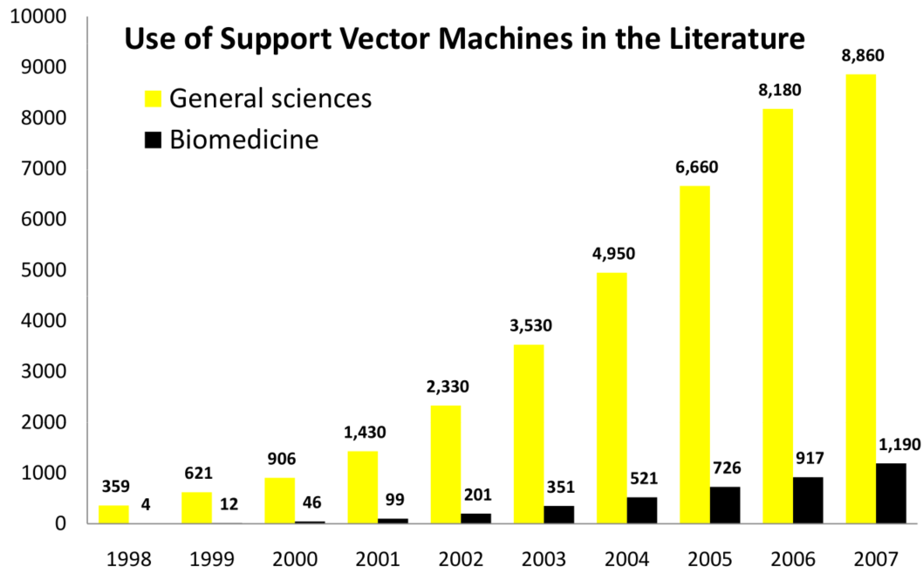
Support Vector Machine (SVM)
Dataset Collection
Feature Extraction
Image Representation
Classifier Training
The impact of SVM on science society
[picture from Statnikov et al.]
Alexander Statnikov, Douglas Hardin, Isabelle Guyon, and Constantin F. Aliferist. A Gentle Introduction to Support Vector Machines in Biomedicine. In Word Scientific, February 22, 2011.

Slide 39
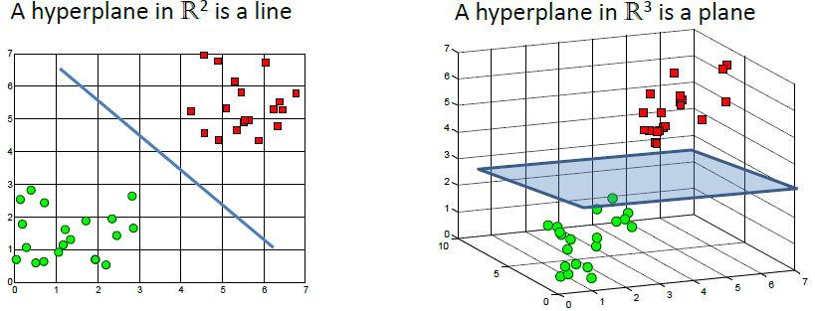
Support Vector Machine (SVM)
Dataset Collection
Feature Extraction
Image Representation
Classifier Training
Motivation
Find out a linear decision surface (“hyperplane”)
[picture from Statnikov et al.]
Alexander Statnikov, Douglas Hardin, Isabelle Guyon, and Constantin F. Aliferist. A Gentle Introduction to Support Vector Machines in Biomedicine. In Word Scientific, February 22, 2011.

Slide 40
Support Vector Machine (SVM)
Motivation
Maximize the gap for linearly separable data
[picture from Statnikov et al.]
Alexander Statnikov, Douglas Hardin, Isabelle Guyon, and Constantin F. Aliferist. A Gentle Introduction to Support Vector Machines in Biomedicine. In Word Scientific, February 22, 2011.

Slide 41
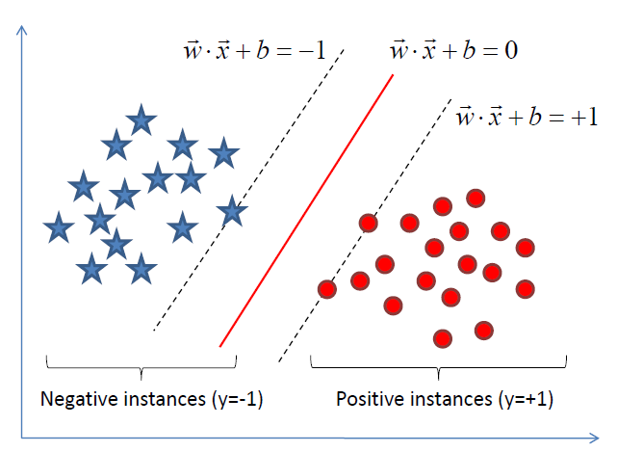
Support Vector Machine (SVM)
Motivation
Maximize the gap for linearly separable data
Separate samples to have the largest margin between two border-line samples (support vectors)
[picture from Statnikov et al.]
Alexander Statnikov, Douglas Hardin, Isabelle Guyon, and Constantin F. Aliferist. A Gentle Introduction to Support Vector Machines in Biomedicine. In Word Scientific, February 22, 2011.

Slide 42
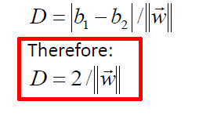
Support Vector Machine (SVM)
Main idea of SVM
Maximize the gap for linearly separable data
Gap
To maximize the gap,
we need to minimize $\left\|\vec{w}\right\|$
[picture from Statnikov et al.]
Alexander Statnikov, Douglas Hardin, Isabelle Guyon, and Constantin F. Aliferist. A Gentle Introduction to Support Vector Machines in Biomedicine. In Word Scientific, February 22, 2011.

Slide 43
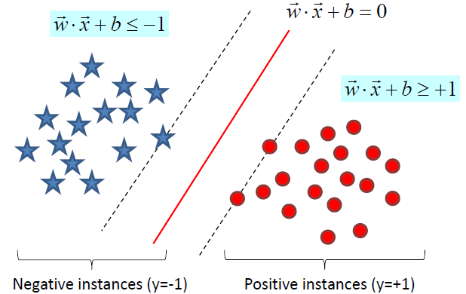
Support Vector Machine (SVM)
Statement of SVM
Minimize $\left\|\vec{w}\right\|$ subject to $y_{i}\left(\vec{w}∙\vec{x_{i}}+b\right)≥1$ for $i=1,…,N$
Given a new sample/instance $x$, the classifier is
$$f\left(\vec{x}\right)=sign(\vec{w}∙\vec{x}+b)$$
Equivalently
$$y_{i}\left(\vec{w}∙\vec{x_{i}}+b\right)≥1$$
[picture from Statnikov et al.]
Alexander Statnikov, Douglas Hardin, Isabelle Guyon, and Constantin F. Aliferist. A Gentle Introduction to Support Vector Machines in Biomedicine. In Word Scientific, February 22, 2011.

Slide 44
Support Vector Machine (SVM)
SVM Optimization from a primal view
Minimize $\left\|\vec{w}\right\|$ subject to $y_{i}\left(\vec{w}∙\vec{x_{i}}+b\right)≥1$ for $i=1,…,N$
Problem transformation:
Maximize Gap→min $\left\|\vec{w}\right\|$→ min ${\left\|\vec{w}\right\|}^{2}$→ min $\frac{1}{2}{\left\|\vec{w}\right\|}^{2}$
Objective function
Constraints

Slide 45
Support Vector Machine (SVM)
SVM Optimization from a dual view
Minimize $\left\|\vec{w}\right\|$ subject to $y_{i}\left(\vec{w}∙\vec{x_{i}}+b\right)≥1$ for $i=1,…,N$
Apply the method of Lagrange multipliers
Objective function
$$\frac{1}{2}{\left\|\vec{w}\right\|}^{2}$$
Constraints
[picture from Statnikov et al.]
Alexander Statnikov, Douglas Hardin, Isabelle Guyon, and Constantin F. Aliferist. A Gentle Introduction to Support Vector Machines in Biomedicine. In Word Scientific, February 22, 2011.

Slide 46
Support Vector Machine (SVM)
Advancements of using dual formulation
Access only dot products rather than original data
Beneficial for high-dimensional input vectors
Primal formulation:
Training: min $\frac{1}{2}{\left\|\vec{w}\right\|}^{2}$ subject to $y_{i}\left(\vec{w}∙\vec{x_{i}}+b\right)≥1$
Testing: $f\left(\vec{x}\right)=sign(\vec{w}∙\vec{x}+b)$
Dual formulation:
Training: min $\sum_{i=1}^{N}{a_{i}}−\frac{1}{2}\sum_{j=1}^{N}{a_{i}{a_{j}y}_{i}y_{j}}\vec{x_{i}}$ $∙\vec{x_{j}}$
Testing: $f\left(\vec{x}\right)=sign(\sum_{i=1}^{N}{a_{i}y_{i}}\vec{x_{i}}∙\vec{x}+b)$

Slide 47
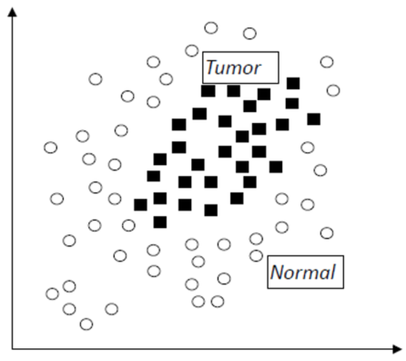
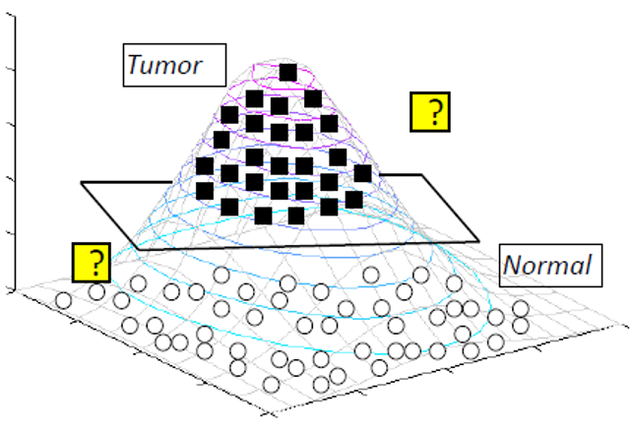
Support Vector Machine (SVM)
Motivation
Perform kernel trick for non-linearly separable data
Kernel
Data is not separable in the input space
Data is separable in the feature space obtained by the kernel
[picture from Statnikov et al.]
Alexander Statnikov, Douglas Hardin, Isabelle Guyon, and Constantin F. Aliferist. A Gentle Introduction to Support Vector Machines in Biomedicine. In Word Scientific, February 22, 2011.

Slide 48
Support Vector Machine (SVM)
Kernel Trick for non-linearly separable data
Original Space $\vec{x}:$ $f\left(\vec{x}\right)=sign\left(\sum_{i=1}^{N}{a_{i}y_{i}}\vec{x_{i}}∙\vec{x}+b\right)$
Mapped Space $Φ(\vec{x})$:
We don’t need to know $Φ$ explicitly, we just need to employ the positive semi-definite function* $K\left(∙,∙\right):$
$$f\left(\vec{x}\right)=sign\left(\sum_{i=1}^{N}{a_{i}y_{i}}Φ(\vec{x_{i}})∙Φ(\vec{x})+b\right)$$
$$K\left(\vec{x_{i}},\vec{x_{j}}\right)=Φ(\vec{x_{i}})∙Φ(\vec{x_{j}})$$
*Mohri, Mehryar; Rostamizadeh, Afshin; Talwalkar, Ameet (2012). Foundations of Machine Learning. USA, Massachusetts: MIT Press.

Slide 49
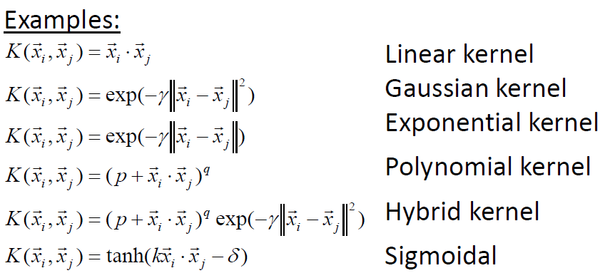
Support Vector Machine (SVM)
A Kernel is a dot product in some feature space.
Popular Kernel
Alexander Statnikov, Douglas Hardin, Isabelle Guyon, and Constantin F. Aliferist. A Gentle Introduction to Support Vector Machines in Biomedicine. In Word Scientific, February 22, 2011.

Slide 50
Deep Learning based Approaches

Slide 51
Deep Learning (DL)
Dataset Collection
Feature Extraction
Image Representation
Classifier Training
Though building and training neural networks, DL proposes to jointly learn feature extraction, image representation and classifier (e.g., softmax classifier).
Advantages:
Feature is automatically learned.
Superior performance on large scale databases.
Easy for parallelization
Disadvantage-unclear decision making (black box)

Slide 52
Hierarchical Abstraction as human brain
Inspired by the human brain study, we propose to process image hierarchically from bottom to top.
[picture from Honglak Lee]

Slide 53
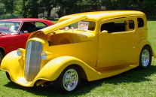
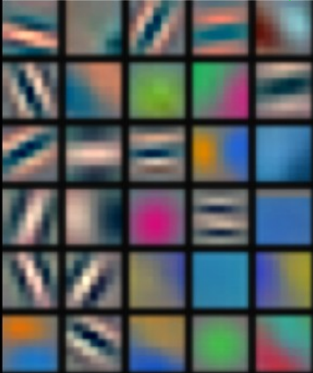
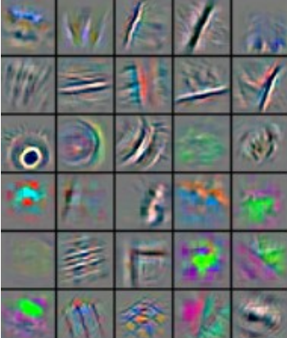
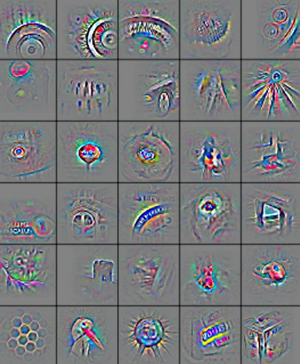
Deep Learning = Learning Hierarchical Representations
Low-Level Feature
Mid-Level Feature
High-Level Feature
Trainable
Classifier
Feature visualization of convolutional net trained on ImageNet from [Zeiler & Fergus 2013]

Slide 54
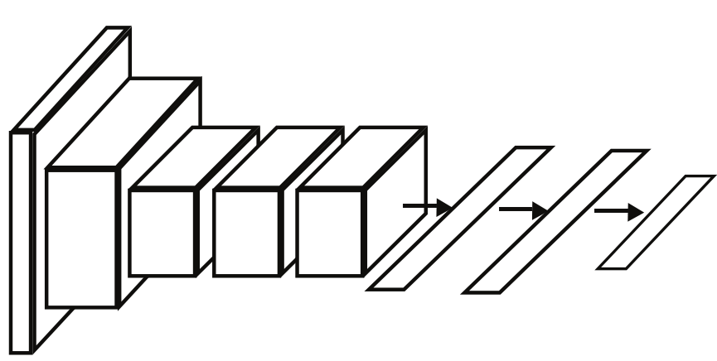
Deep Learning for Image Classification
Main Components
Input: a vector of all image pixels
Deep Network: Feature representation + Softmax Classifier
Output: a vector of label probabilities. For instance, the i-th neuron is corresponding to the i-th object category.
id | label | Probability
0 | Cat | 0.9
1 | Dog | 0.05
2 | Cow | 0.03
3 | Car | 0.02
Input
Deep Network
Output

Slide 55
Deep Learning for Image Classification
Common Pipeline
Dataset Collection
Network
Design
Network
Finetuning
Collect image and object label pair (x, y)
Design the type and number of neural layers
Optimize the parameters of network
Input: Images and the corresponding labels
Output: Trained network

Slide 56
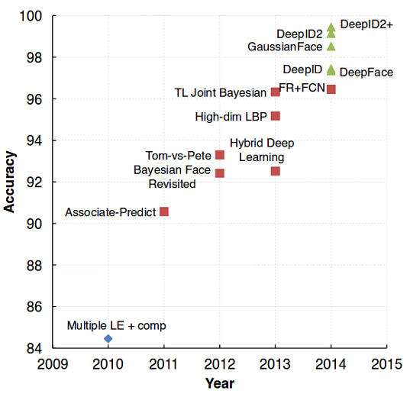
Deep Learning for Image Classification
Dataset Collection
Network
Design
Network
Finetuning
Dataset Collection
Require large amount of training samples
How big data impact
face image classification ?
Erjin Zhou, Zhimin Cao, and Qi Yin. Naive-Deep Face Recognition: Touching the Limit of LFW Benchmark or Not? In arxiv, 1501.04690.

Slide 57
Deep Learning for Image Classification
Dataset Collection
Generalization performance is difficult to obtain.
Construct training, validation and test set.
Dataset Collection
Network
Design
Network
Finetuning
Bad Idea
Try out best hyperparameters on test set.
Training data
Test data
Better way: test data is a proxy for the generalization performance
Turn hyperparameters on validation set.
Training data
Training data
Validation data
Test data

Slide 58
Deep Learning for Image Classification
Network Design
Initialization: Understand the basic concepts of all kinds of neural layers, e.g., the convolutional layer, pooling layer, fully connected layer, and batch normalization layer.
Construction: Build up the neural layers in a deep preferred fashion. Meanwhile, control the number of parameters.
The deeper is the better.
Plenty of parameters may result in poor performance.
Learn from the existing network architecture
Dataset Collection
Network
Design
Network
Finetuning

Slide 59
Deep Learning for Image Classification
Dataset Collection
Network
Design
Network
Finetuning
The more layers (deeper), the better performance!!!
Alex Krizhevsky
Andrew Zisserman
Yann LeCun
Geoffrey E. Hinton
Karen Simonyan
Christian Szegedy
Kaiming He
LeNet
1998
5 layers
AlexNet
2012
7 layers
VGGNet
2014~2015
19 layers
GoogleNet
2014~2016
22 layers
ResNet
2016
1000+ layers

Slide 60
Deep Learning for Image Classification
Typical Architecture
One Stage
Whole Networks
Dataset Collection
Network
Design
Network
Finetuning
Conv: Convolutional Layer
Pooling: Pooling Layer
FC: Fully Connected Layer
Conv
Pooling
Input Images
FC
Class Labels
1st Stage
2nd Stage
3rd Stage

Slide 61
Example: LeNet
LeNet-5 for Handwritten Digit Image Classification
Network Architecture:
Conv-Pooling-Conv-Pooling-FC-Softmax Classifier
Layer 1
Layer 2
Layer 3
Input
[picture from Y. LeCun]
Y. LeCun, L. Bottou, Y. Bengio, and P. Haffner. Gradient-based learning applied to document recognition. Proceedings of the IEEE, november 1998.

Slide 62
Example: AlexNet
ImageNet Classification Challenging (ILSVRC) 2012 Winner (84% accuracy)
Remarkable Improvement in Image Classification (The best traditional method can only achieve 73%)
Alex Krizhevsky, Ilya Sutskever and Geoffrey E Hinton, ImageNet Classification with Deep Convolutional Neural Network, In NIPS, pp. 1097--1105, 2012.

Slide 63
Example: VGGNet
ImageNet Classification Challenging (ILSVRC) 2014 (93% accuracy)
Much deeper than AlexNet (19 against 7)
K. Simonyan, A. Zisserman. Very Deep Convolutional Networks for Large-Scale Image Recognition. In ICLR 2015 (oral).

Slide 64
Network Design
Popular Architecture: Multi-scale
Perform classification on different scales of the original image
Benefit for encoding regions of multiple sizes centered on each pixel
Small Scale
downsamping
Input Images
Original Scale
FC
Class Labels
upsampling
Large Scale

Slide 65
Examples
Liu et al. “Learning Multi-Scale Deep Features for High-Resolution Satellite Image Classification” In CoRR, 2016.
Farabet et al. “Learning hierarchical features for scene labeling” In T-PAMI 2013.

Slide 66
Network Design
Popular Architecture: Multi-Modal
Input: image with additional data source, e.g., depth information map, video or text description
The additional data contribute to more context and guidance for the classification task
Image
FC
Class Labels
Additional data

Slide 67
Example
Popular Architecture: Multi-Modal
Early Fusion: concatenate RGB data and depth data together, and then extract features
Later Fusion: concatenate features which are extracted from RGB data and depth data respectively
Early Fusion
Later Fusion
Ling Shao, Ziyun Cai, Li Liu, Ke Lu and Lei Zhang, “Performance evaluation of deep feature learning for RGB-D image/video classification”, In Information Science, 2017.

Slide 68
Network Design
Popular Architecture: Multi-Task
Output: Multiple purpose. Not only main classification task, but also other correlated tasks.
Observation from Caruana*: Learn multiple correlated tasks simultaneously may significantly improve the performance of the main task.
Class Labels
Input Images
FC
Task Two
Task Three
R. Caruana. Multitask learning. Machine learning, 28:41–75, 1997.

Slide 69
Example
Popular Architecture: Multi-Task
Task One: Whether an object? — Objectness Estimation
Task Two: Which category?—Categoryness Calculation
Keze Wang, Liang Lin*, Wangmeng Zuo, Shuhang Gu, and Lei Zhang, "Dictionary Pair Classifier Driven Convolutional Neural Networks for Object Detection", In CVPR, 2016.

Slide 70
Example
Multi-Task Network Cascade
Jifeng Dai, Kaiming He, and Jian Sun. "Instance-aware Semantic Segmentation via Multi-task Network Cascades", In CVPR, 2016.

Slide 71
Network Design
Popular Architecture: Generic Directed Acyclic Graph
Class Labels
The information can be propagated across layers in a rapid manner.
Beneficial for very deep CNNs
Input Images
[picture from Marc'Aurelio Ranzato]
Rupesh Kumar Srivastava, Klaus Greff, Jürgen Schmidhuber. Highway Networks, In CoRR, 2015.

Slide 72
Example: GoogLeNet
ImageNet Classification Challenging 2014 (93%)
Basic Structure: Inception
Inception-A
Inception-B
Inception-C
C. Szegedy et al. Going deeper with Convolutions. In CoRR 2014.

Slide 73
Example: ResNet
ImageNet Classification Challenging 2016 Winner (96%)
Overcome the gradient vanishing problem
Made by building blocks (can be significantly deeper)
Block: Adding shortcut connections that are summed with the output of the convolution layers
Kaiming He, Xiangyu Zhang, Shaoqing Ren, and Jian Sun. Deep Residual Learning for Image Recognition In CVPR 2016. (Best Paper Award)

Slide 74
Deep Learning for Image Classification
Dataset Collection
Network
Design
Network
Finetuning
Network Finetuning
Loss Function: The objective function measures the difference (i.e., loss) between the predicted results and ground truth.
Optimization Strategy: The network parameters are updated/fine-tuned to minimize the loss.

Slide 75
Deep Learning for Image Classification
Dataset Collection
Network
Design
Network
Finetuning
Popular Loss Function: Sigmoid Cross-Entropy Loss
N is the number of training samples
S is the output class probability of the network
Only support for binary classification
Sigmoid operation
for each sample
Total Loss Function

Slide 76
Popular Loss Function
Softmax Loss (Dominantly used)
N is the number of training samples
W denotes the network parameters
S is the output class probability of the network
is the score of the correct class
is the score of the j-th class
Loss for each sample
Total Loss Function
parameter regularization

Slide 77
Popular Loss Function
Infogain Loss
H is infogain matrix, if H=I, infogain loss equals to Multinomial Logistic Loss
is the predicted probability of each classes,
Predicted probability of the k-th class
Total Loss Function

Slide 78
Popular Loss Function
Hinge Loss
N is the number of training samples
w is the output class probability of the network
is the parameter of the k-th SVM classifier
is the parameter of the correct SVM classifier
Hinge Loss for each sample
Total Loss Function

Slide 79
Deep Learning for Image Classification
Network Finetuning
Optimize network parameters via Stochastic gradient descent (SGD), Momentum, Nesterov accelerated gradient (NAG), Adagrad, Adadelta, RMSprop and Adaptive Moment Estimation (Adam)
Dataset Collection
Network
Design
Network
Finetuning
Optimization loss surface
(Note that different methods has different convergence)
[picture from Sebastian Ruder’s tutorial]

Slide 80
Practice Tutorial
Selected Dataset: Food-101*
A challenging data set of 101 food categories with 101000 images. (1000 per category)
All images were rescaled to have a maximum side length of 512 pixels.
L. Bossard et al. Food-101 -- Mining Discriminative Components with Random Forests. In ECCV 2014.

Slide 81
Practice Tutorial
Used Deep Learning Toolbox: Caffe
Expressive architecture
Extensible code
Speed: Implemented in C++
More Details: http://caffe.berkeleyvision.org/

Slide 82
Practice Tutorial
Data Preprocessing
Transform food category into numerical id.
Construct training, validation and testing sample set by using create_imageset.sh
Training sample number: 70700 (70%)
Validating sample number: 5050 (5%)
Testing sample number: 25250 (25%)
…

Slide 83
Practice Tutorial
Choose network architecture
Already set up in train_lenet.sh, train_alexnet.sh…
LeNet (5 layers)
AlexNet (7 layers)
VGGNet (16 layers)
ResNet (101 layers)

Slide 84
Practice Tutorial
Pick out the loss function and optimization strategy
Since the number of categories is large, softmax loss is preferred.
Due to large amount of training samples, stochastic gradient descent (SGD) is enough.

Slide 85
Practice Tutorial
Fine-tune the network until the average accuracy reach convergence on validation sample set

Slide 86
Practice Tutorial
Report the average accuracy on the testing data
Run test_lenet.sh, test_alexnet.sh test_vggnet.sh test_resnet.sh
Run time_lenet.sh, time_alexnet.sh time_vggnet.sh time_resnet.sh
Performance: ResNet > VGGNet > AlexNet > LeNet
Efficiency: ResNet < VGGNet < AlexNet < LeNet
Net | LeNet | AlexNet | VGGNet | ResNet
Accuracy | 58.3% | 69.3% | 91.9% | 93.9%
Efficiency (CPU) | 52s | 95s | 122s | 153s

Slide 87
Unsolved Problems

Slide 88
Multi-label Image Classification
Problem Definition: Identify an image that can belong to multiple classes/categories.
The objective is to regress a label vector belongs to {0, 1}.
Label Vector
[1 1 0 0 0 0 …]
[1 0 1 0 1 0 …]
[1 1 0 0 0 0 …]
[0 0 0 1 0 0 …]

Slide 89
Multi-label Image Classification
CNN: Single-label to Multi-label
A set of hypothes are first extracted via objectness detection
The output is obtained by cross-hypothesis max-pooling
operation
Yunchao Wei et al. CNN: Single-label to Multi-label. In CoRR 2014.

Slide 90
Multi-label Image Classification
Training Phase
Yunchao Wei et al. CNN: Single-label to Multi-label. In CoRR 2014.

Slide 91
Multi-label Image Classification
Testing Phase
Yunchao Wei et al. CNN: Single-label to Multi-label. In CoRR 2014.

Slide 92
Semi-supervised Image Classification
Make use of unlabeled images for training
Initialized with a small amount of labeled images
Incrementally added with a large amount of unlabeled images
Unlabeled Images
Performance

Slide 93
Semi-supervised Image Classification
Human Machine Collaboratively Learning
High-confidence sample labeling by Pseudo-labeling
Low-confidence sample annotating by active user annotating

Slide 94
Beyond Image Classification
Know what’s inside image is not enough !!!
From recognition to understanding as human
Human can identify more attributes, e.g., place, context.
Human can inference the theme behind the images
Indoor
Outdoor
Time fly! Face changes!

Slide 95
Recognition → Understanding
Question: Where is this picture taken?
kettle
Answer: In the ping-pong room.
person
Question: What’s going on?
Answer: A person is pouring the water, he is going to drink it.
racket
Question: The theme of this picture?
cup
Answer: A person is thirsty due to play ping-pong. He would like to drink some water.
ping-pong Table
Cause & Effect
User Intention

Slide 96
Reference materials
Books
Deep Learning
Neural Network and Deep Learning
Video courses
CS231n: Convolutional Neural Networks for Visual Recognition (Stanford)
Machine Learning (Oxford)
Github
Theano, Tensorflow, Keras, MXNet, Caffe

