Slide 1
Deep Reconfigurable Models with Radius-Margin Bound for
3D Human Activity Recognition

Slide 2
Outline
Background
Related Works
Motivation
Framework
Results
Conclusion

Slide 3
Outline
Background
Related Works
Motivation
Framework
Results
Conclusion

Slide 4
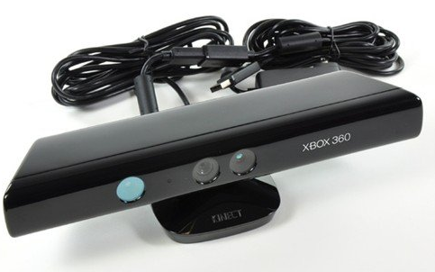
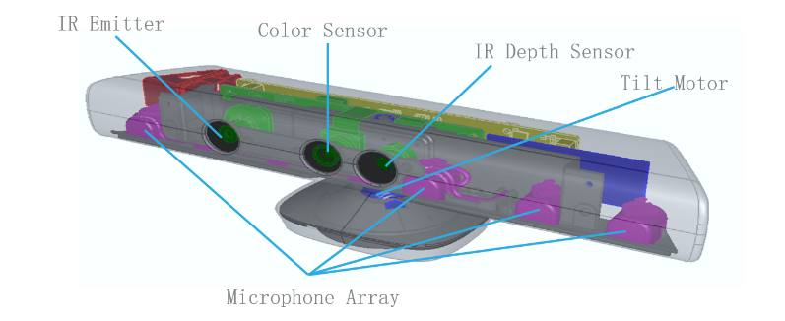
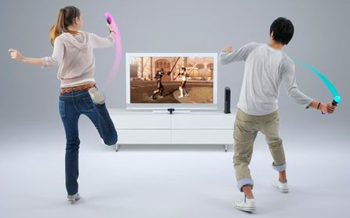
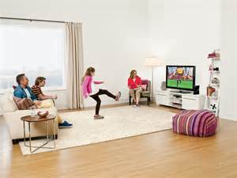
Background

Slide 5
Outline
Background
Related Works
Motivation
Framework
Results
Conclusion

Slide 6
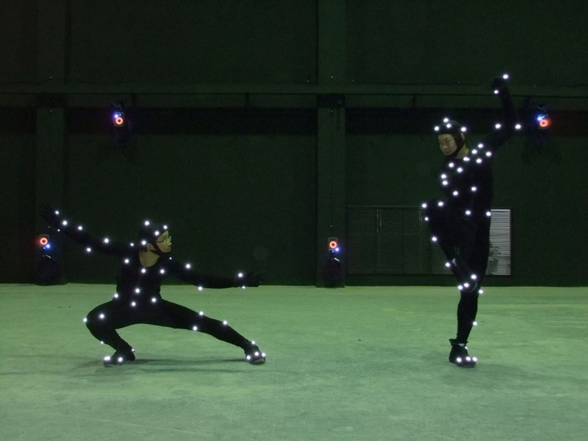
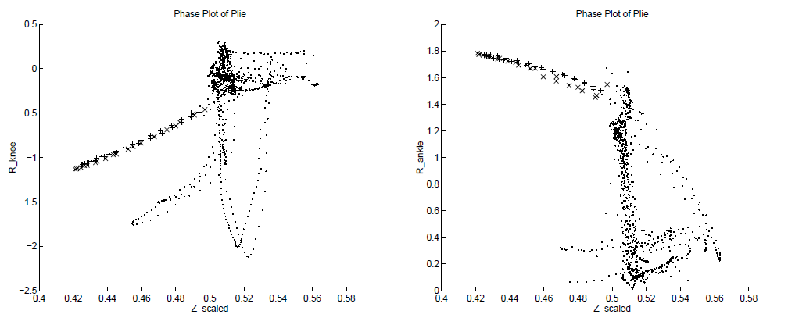
Joints as Feature
Recognizing nine atomic marker movements from Motion Capture Data (MoCap)
Curves in 2D phase spaces (joint angle vs. height of hips)
Supervised learning for selecting phase spaces
[ L. Campbell and A. Bobick. Recognition of human body motion using phase space constraints. ICCV 1995 ]

Slide 7
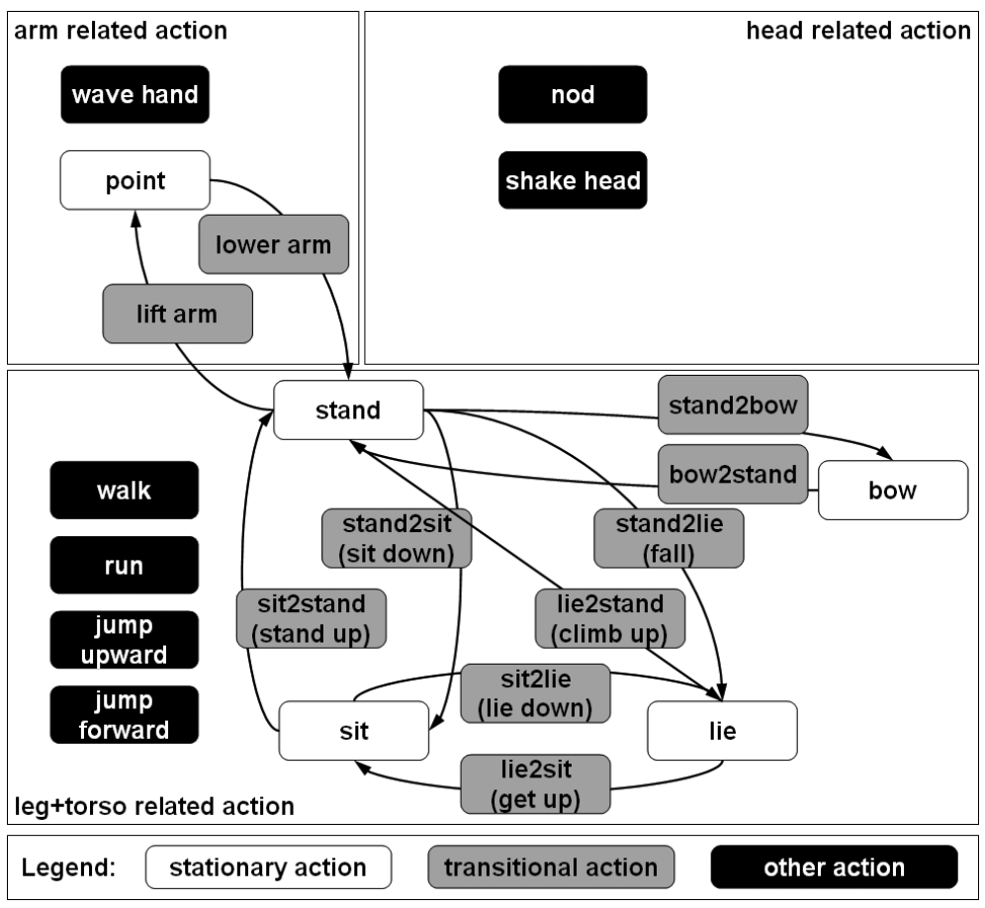
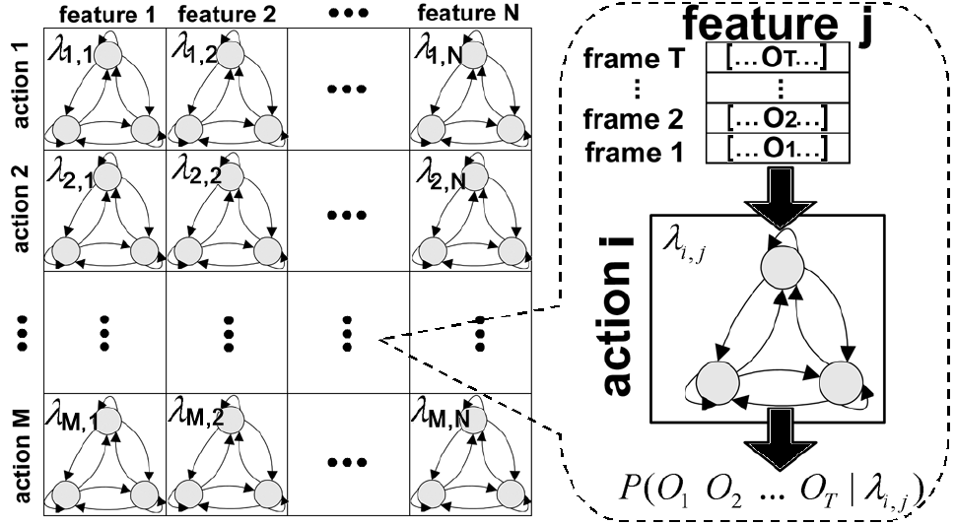
HMMs
Feature: Dynamics of single joints modeled by HMM
Classifier: HMMs as weak classifiers for AdaBoost
[ F. Lv and R. Nevatia. Recognition and segmentation of 3-d human action using hmm and multi-class adaboost. ECCV 2006 ]

Slide 8
Histogram of 3D Joint Locations
Reference: Joint locations relative to hip in spherical coordinates
Pose Feature: Quantization using soft binning with Gaussians
Classifier: LDA + Codebook of poses (k-means) + HMM
[ L. Xia et al. View invariant human action recognition using histograms of 3d joints. HAU3D 2012 ]

Slide 9
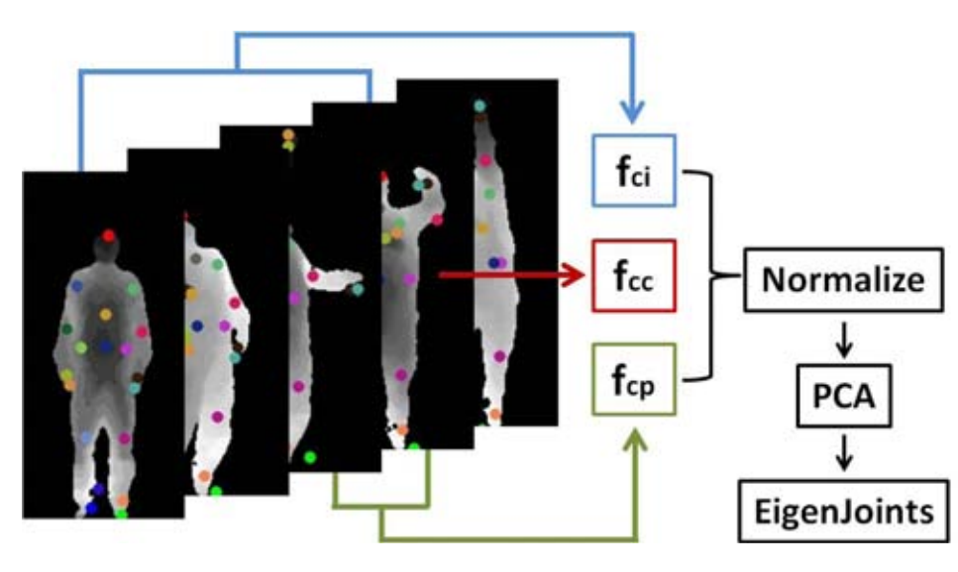
EigenJoints
Integrated pose feature: Classifier: Naïve Bayes Nearest Neighbor f_{cc}: spatial joint differences f_{cp}: temporal joint differences f_{ci}: pose difference to initial pose
[ X. Yang and Y. Tian. Eigenjoints-based action recognition using naive-bayes-nearest-neighbor. HAU3D 2012 ]

Slide 10
Relational Pose Feature
Feature: Spatio-temporal relation between joints, e.g.,
Classifier: Classification and regression forest for action recognition
[ A. Yao et al. Does human action recognition benefit from pose estimation? BMVC 2011 ]
[ A. Yao et al. Coupled action recognition and pose estimation from multiple views. IJCV 2012 ]

Slide 11
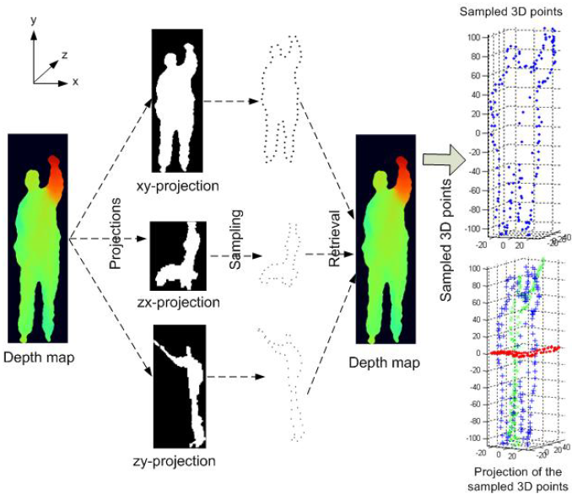
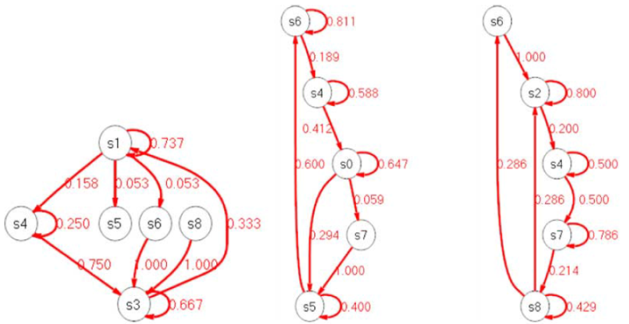
Silhouette (轮廓) Posture
Depth Map as Feature
Project depth maps
Select 3D points as pose representation
Gaussian Mixture Model to model spatial locations of points
Action Graph:
[ W. Li et al. Action recognition based on a bag of 3d points. HAU3D 2010 ]

Slide 12
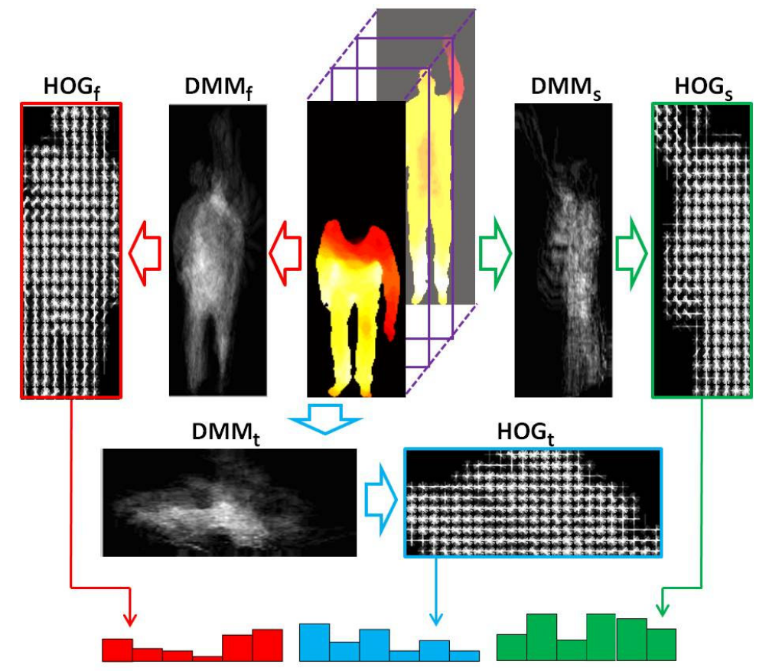
Depth Motion Maps
Project depth maps and compute differences:
HOG + SVM
[ X. Yang et al. Recognizing actions using depth motion maps-based histograms of oriented gradients. ICM 2012 ]

Slide 13
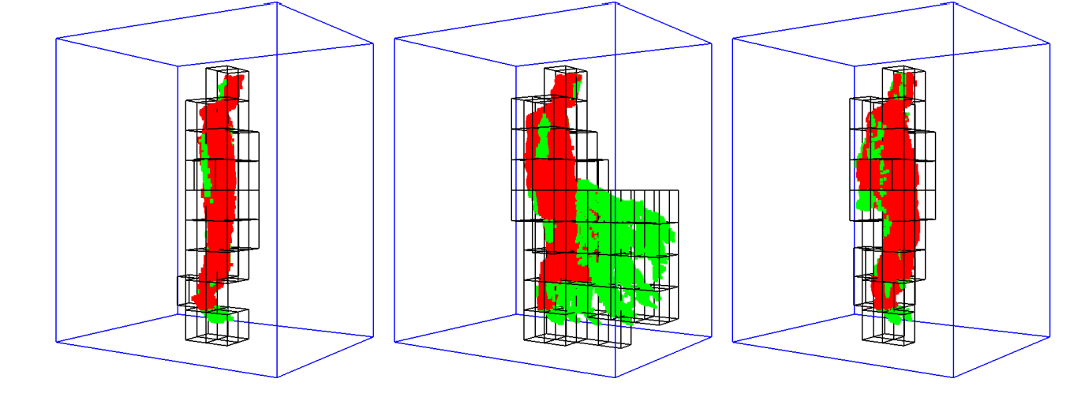
Space-Time Occupancy Patterns
Silhouettes are sensitive to occlusion and noise
Clip (5 frames) as 4D spatio-temporal grid
Feature vector: Number of points per cell
[ A. Vieira et al. STOP: Space-Time Occupancy Patterns for 3D Action Recognition from Depth Map Sequences. LNCS 2012 ]

Slide 14
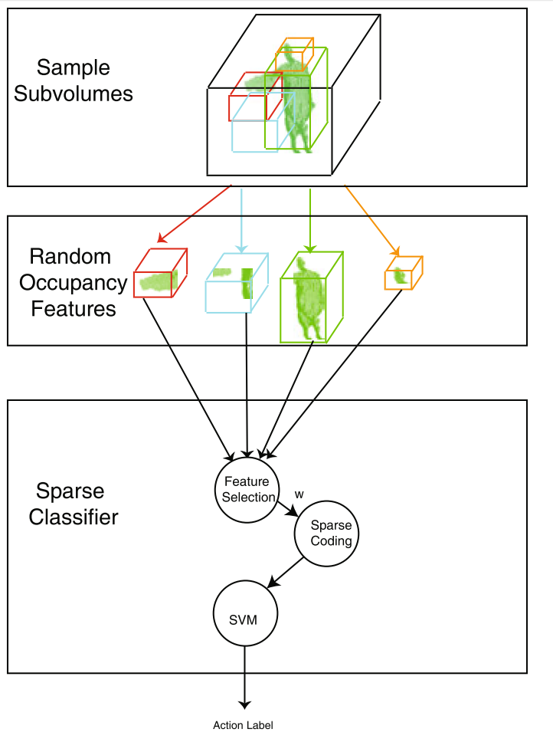
Random Occupancy Patterns
Compute occupancy patterns from spatio-temporal subvolumes
Select subvolumes based on Within-class scatter matrix (S_{W}) and Between-class scatter matrix (S_{B}):
Sparse coding + SVM
[ J. Wang et al. Robust 3d action recognition with random occupancy patterns. ECCV 2012 ]

Slide 15
Histogram of 4D Surface Normals
Surface normals:
Quantization according to “projectors” p_{i}:
Add additional discriminative “projectors”
[ O. Oreifej and L. Zicheng. Hon4d: Histogram of oriented 4d normals for activity recognition from depth sequences. CVPR 2013 ]

Slide 16
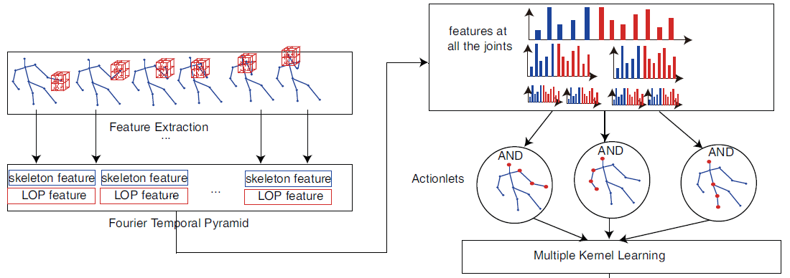
Depth and Joints
Local occupancy features around joint locations
Features are histograms of a temporal pyramid
Discriminatively select actionlets (subsets of joints)
[ J. Wang et al. Mining actionlet ensemble for action recognition with depth cameras. CVPR 2012 ]

Slide 17
Pose and Objects
Spatio-temporal relations between human poses and objects
[ L. Lei et al. Fine-grained kitchen activity recognition using rgb-d. UbiComp 2012 ]
[ H. Koppula et al. Learning human activities and object affordances from rgb-d videos. IJRR 2013 ]

Slide 18
Outline
Background
Related Works
Motivation
Framework
Results
Conclusion

Slide 19
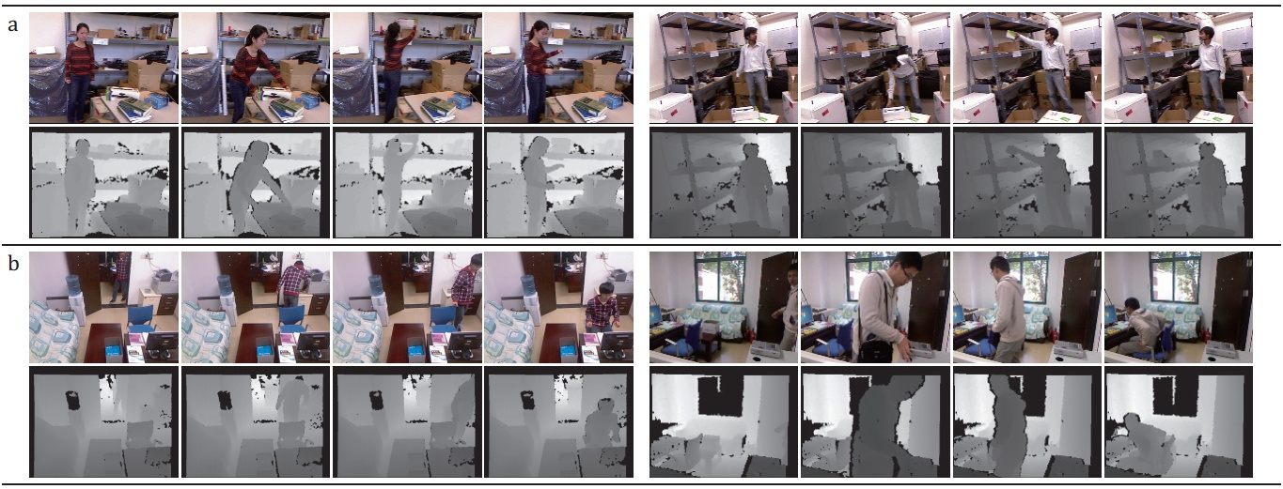
Motivation
Difficulties of complex human activity recognition
Representing complex human appearance and motion information.
Activity examples (diverse poses/views of individuals)
Notes:
1) It is usually hard to retrieve accurate body information with motions due to diverse poses/views of individuals.
2) depth maps are often unavoidably contaminated, and may become un-stable due to sensor noises or self-occlusions of bodies.
3) First row: two activity example from CAD 120 dataset, and two subjects perform the same activity (arranging-objects)
Second row: two activity example from proposed OA dataset, and two subjects perform the same activity (going-to-work)

Slide 20
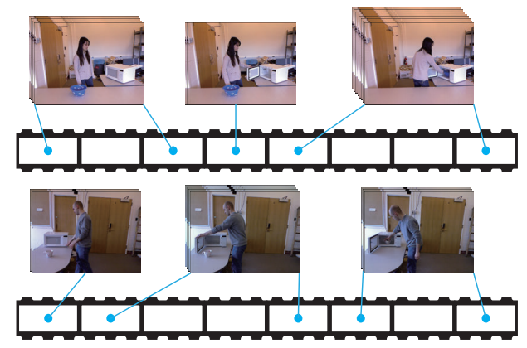
Motivation
Difficulties of complex human activity recognition
Capturing large temporal variations of human activities.
Variant
temporal
lengths
Activity = Temporal compositions of actions
Notes:
We consider one activity as a sequence of actions occurred over time.
(a) temporal compositions of actions are diverse by different subjects.
(b) the temporal lengths of decomposed actions are variant by different subjects
2) Figure is two activities of the same category performed by two subjects.

Slide 21
Motivation
Deep architecture
Act directly on grayscale-depth data.
Reconfigurable structure
Handle large temporal variations of activities via latent variables.
Radius-margin regularization
Conduct the classification with good generalization performance.
Notes:
We build the layered network stacked up by convolutional layers, max-pooling operators and full connection layers, where the raw segmented videos are treated as inputs.
2) Impose the latent variables to capture the temporal compositions of activities by manipulating the activation of neurons.
3) 3D data is small. Small scale training data has very impressive generalization power.

Slide 22
Outline
Background
Related Works
Motivation
Framework
Results
Conclusion

Slide 23
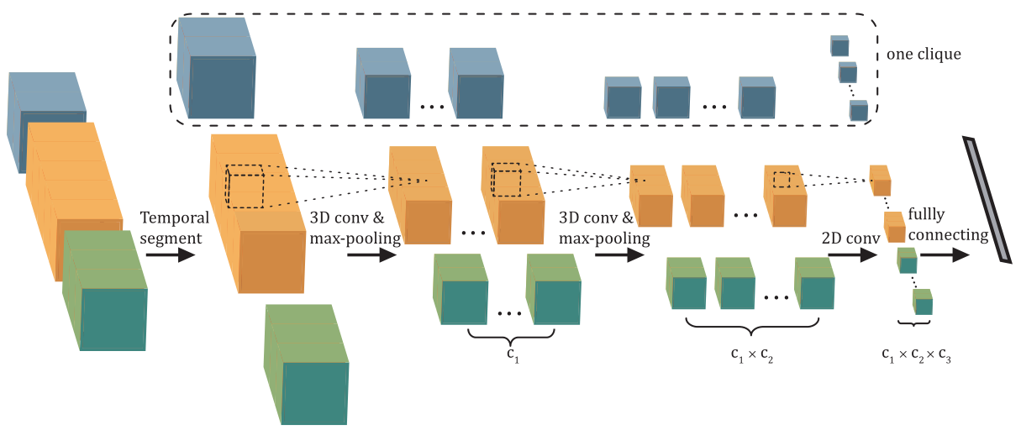
Architecture of spatio-temporal convolutional neural networks
video segment of unfixed length
Notes:
1) The network is stacked up by convolutional layers, max-pooling operators and full connection layers, where the raw segmented videos are treated as the input.
2) A clique is designed as a subpart of the network stacked up for several layers, extracting features for one segmented video.
3) The architecture can be partially enabled to explicitly handle different temporal compositions of the activities.

Slide 24
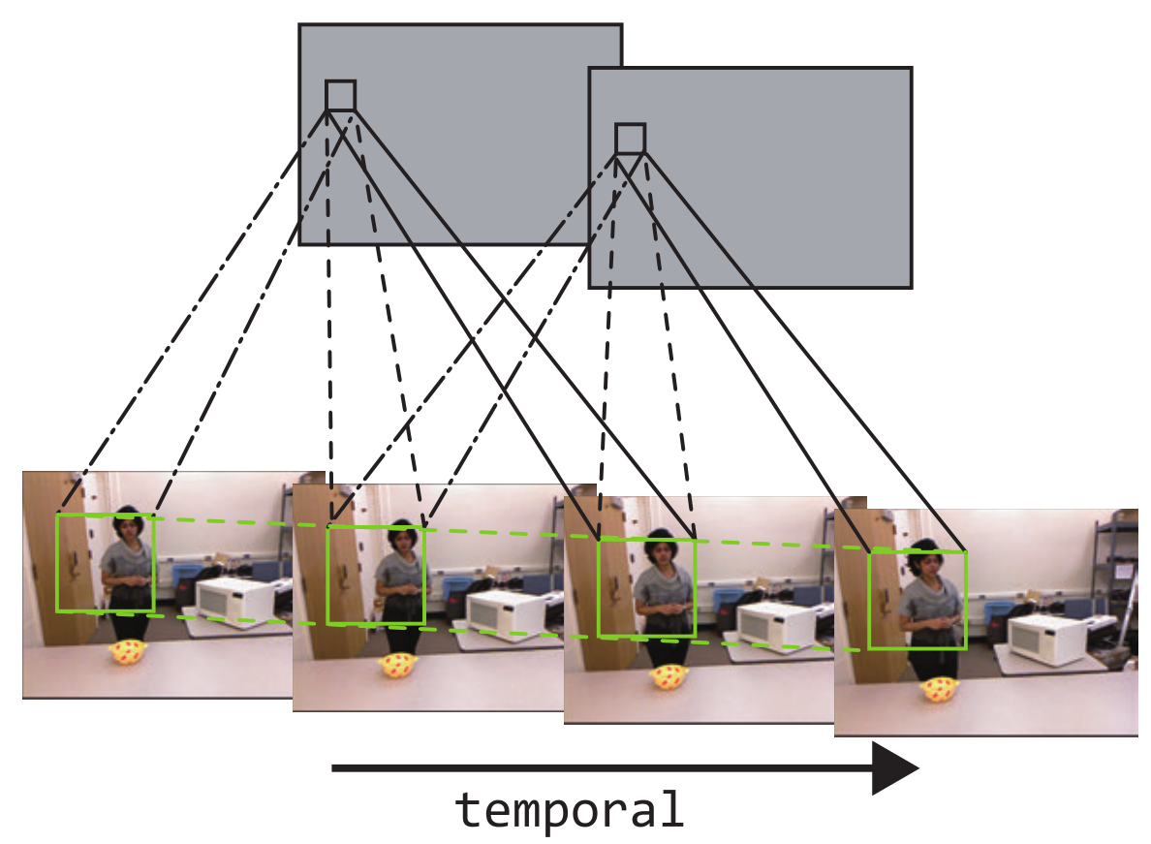
3D Convolution across both spatial and temporal domains
3D Convolution across 3 adjacent frames

Slide 25
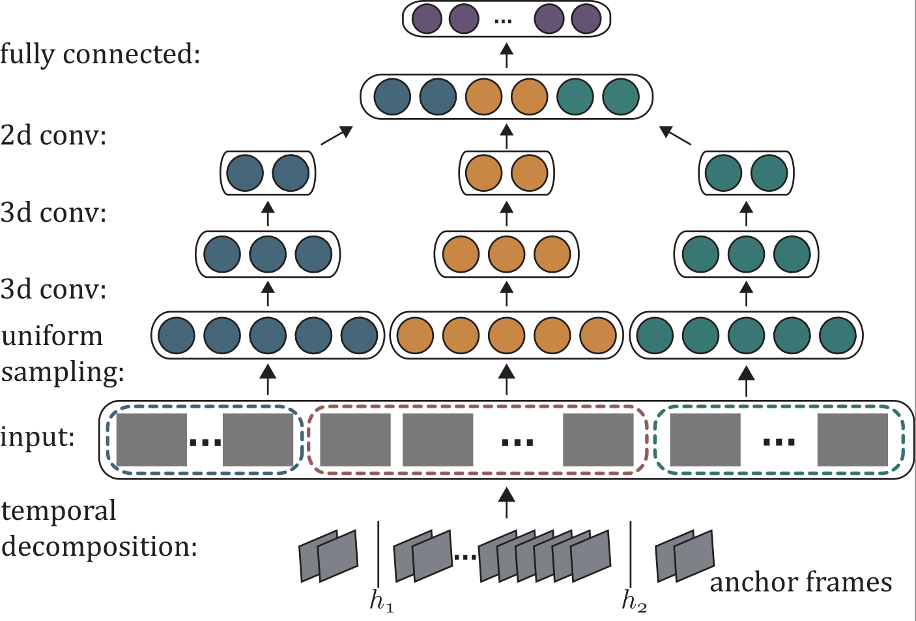
Deep learning with reconfigurable structure
Incorporating the latent variables to manipulate the activation of neurons
Notes:
Different model cliques are represented by different colors.
As the temporal segmentation for an input video can be variant, different cliques might have different number of input frames.
For the cliques whose input frame number less than m, part of the neurons in the network are inactivated, as represented by the dotted blank circles.

Slide 26
Deep model with Linear SVM
Pros: Better generalization performance on small data.
Cons: The margin can be increased by simply expanding
the feature space!

Slide 27
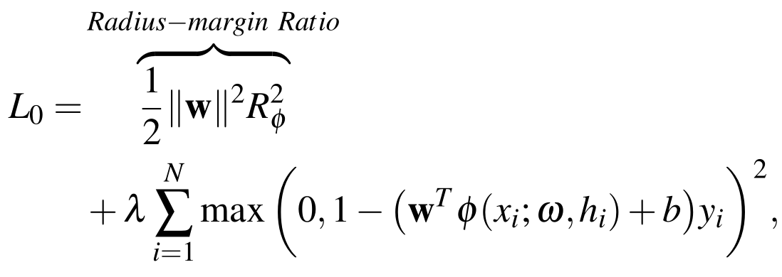
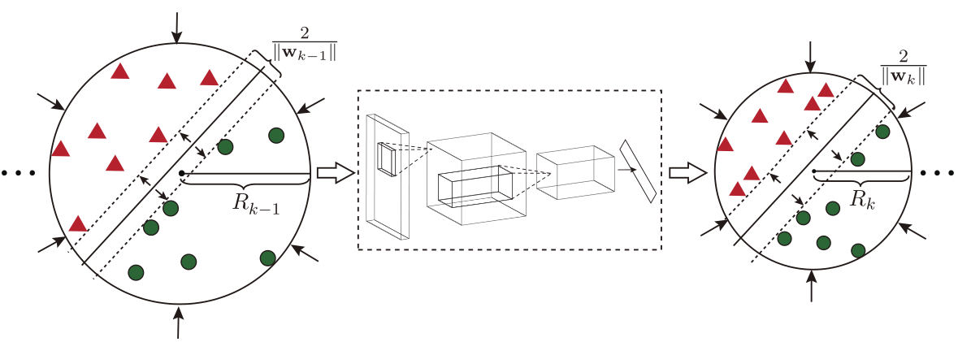
Deep model with relaxed radius-margin bound
Notes:
1) To improve the generalization performance for classification, we propose to integrate the radius-margin bound as a regularizer with the feature learning. Intuitively, together with optimizing the max-margin parameters (w,b), we shrink the radius R of the minimum enclosing ball (MEB) of the training data that distribute in the feature space generated by the CNNs.
2) The resulting classifier with the regularizer shows better generalization performance compared to the traditional softmax output.

Slide 28
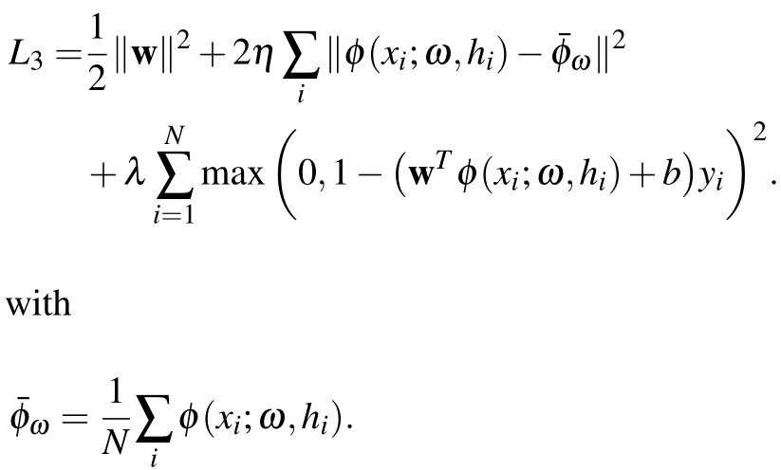
Deep model with relaxed radius-margin bound
Relaxed: mini-batch based

Slide 29
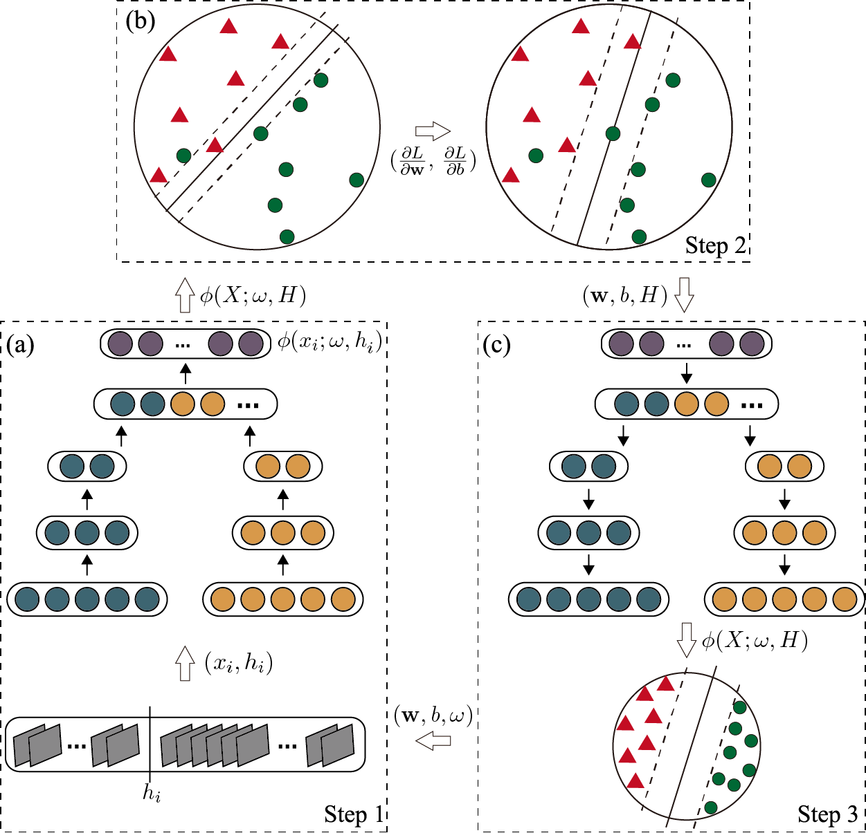
Joint Component Learning

Slide 30
Deep Structured Models
Pre-training
Goal:
1) Handle the insufficient RGB-D data for training.
2) Boosting the activity recognition results.
More details:
Discard the reconfigurability and depth channel.
Train with 2D activity videos with labels (Supervised).
Apply standard back propagation to learn parameters.
Notes:
2D activity videos can be easily accessed. For instance: MPII Human Pose Dataset (http://human-pose.mpi-inf.mpg.de/)
The pre-training steps:
a) Obtain large sum of 2D activity videos with labels.(a supervised manner).
b) Discard the reconfigurability of our deep structure model by segmenting the 2D videos evenly to the number as the number of model cliques.
(i) The initial model parameters are unstable, and it is not reliable to estimate latent variables H with them;
(ii) The training efficiency can be improved without considering the latent variables.
c) Apply standard back propagation to learn parameters.
d) Initialize our model with the learned parameters of the convolutional layers. (gray and depth channels share the learned parameters for the first 3D CNN layer. i.e., we enable gray channel of first 3D CNN layer only during 2D videos for pre-training. After that, we duplicate learned parameters of the gray channel to depth channel.)

Slide 31
Deep Structured Models
Inference
Perform the standard procedure of brute search for activity label and latent variables.
More details:
Given an activity label, we calculate its maximum probability by brute searching across all the temporal segmentations.
Search across all labels.
Choose the label with the maximum.
Accelerate the inference speed via Parallel computation.
(0.4 second per video)

Slide 32
Outline
Background
Related Works
Motivation
Framework
Results
Conclusion

Slide 33
Results
Dataset
CAD-120 activity dataset (120 videos, made by Cornell University)
Office Activity (OA) dataset. (1180 videos, newly created by us)
SBU dataset. (300 videos, made by Stony Brook University)
Challenge
large variance in object appearance, human pose, and viewpoint.
OA and SBU contain two subjects with interactions.
Notes:
OA is nearly ten times larger than CAD-120.
1) The experiments are executed on a desktop with an Intel i7 3.7GHz CPU, 8GB RAM and GTX TITAN GPU. The source is in python with theano library.
2) For model learning, we set the learning rate as 0.002 for applying the stochastic gradient descent algorithm.
3) The training times of one fold are 2 hours for CAD-120 (including 120 videos and occupying 0.2GB), 5 hours for OA1(including 600 videos and occupying 1.0GB), and 5 hours for OA2 (including 580 videos and occupying 0.9GB) dataset, respectively.
4) Due to small training sample, CAD120 only has 120 long videos. We obtain many training videos by sampling the long video with equal stride. For instance, we divide one given video with 90 frames into three small videos with 30 frames via a stride of 3 sampling.

Slide 34
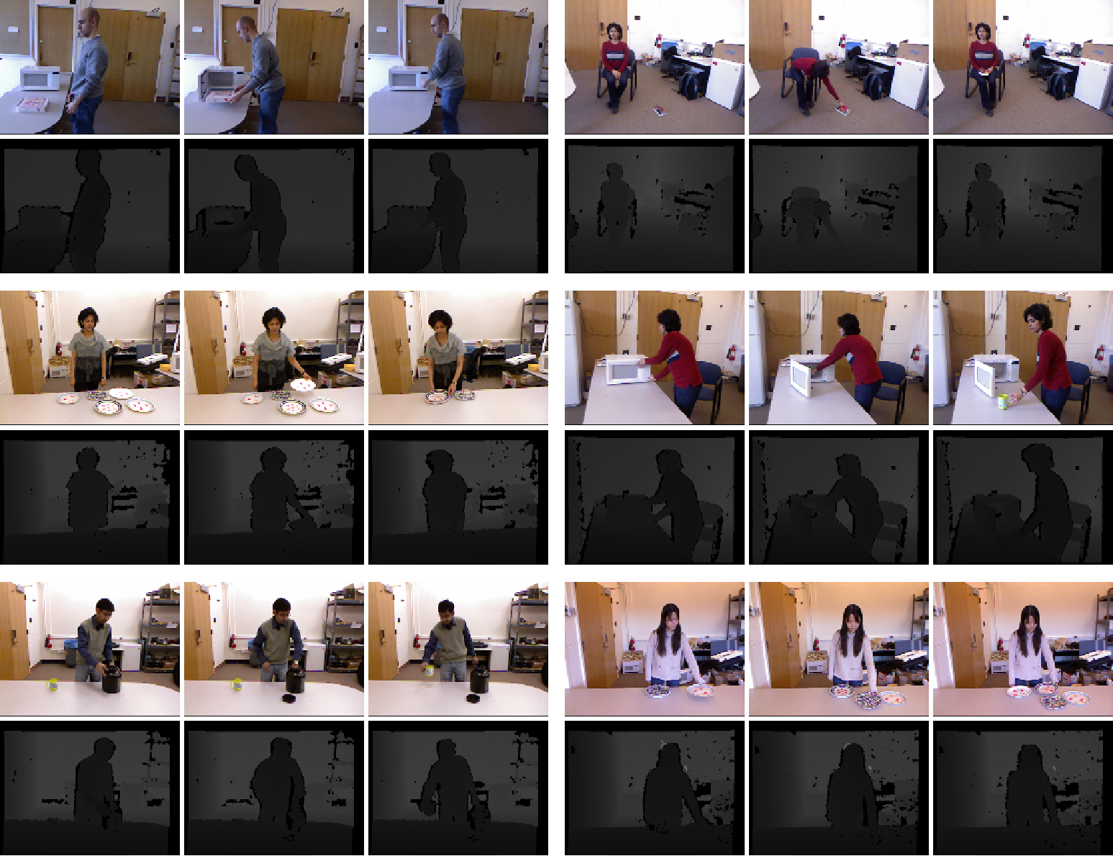
CAD-120
Notes:
CAD-120

Slide 35
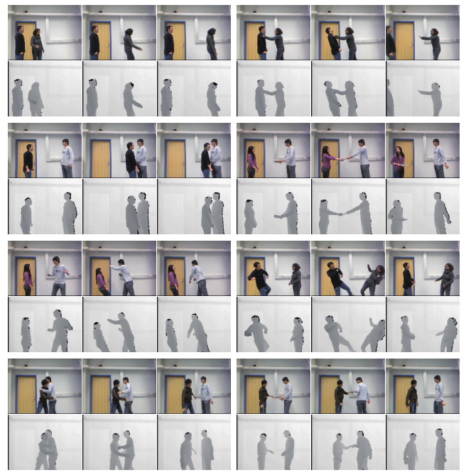
SBU

Slide 36
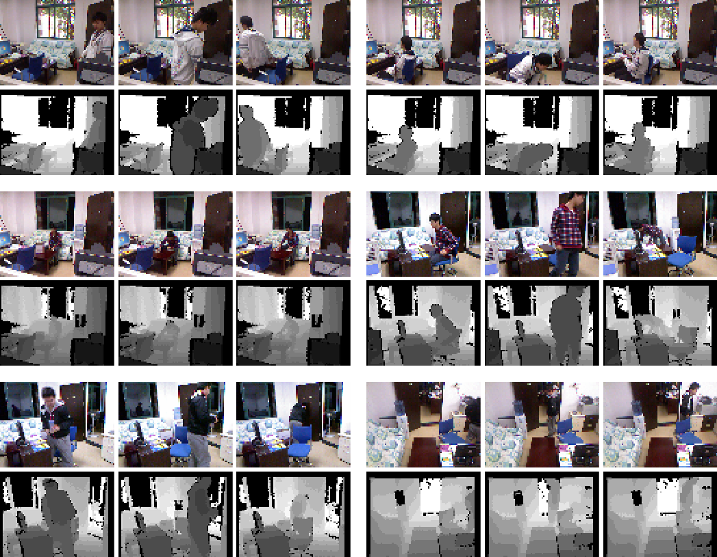
OA-1 (single subject)

Slide 37
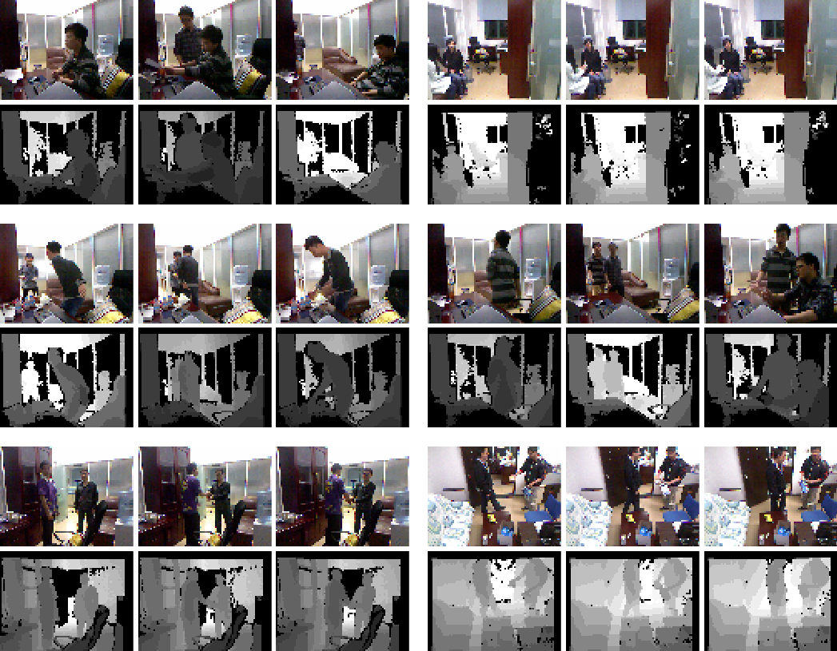
OA-2 (two subjects)

Slide 38
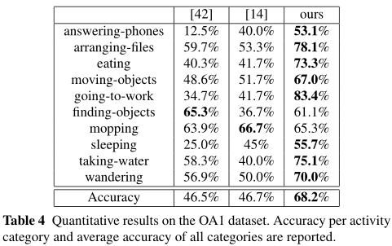
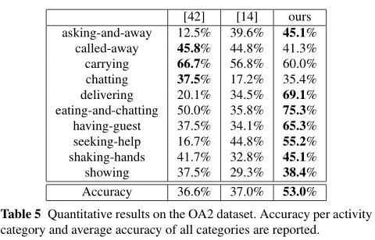
Experimental Results

Slide 39
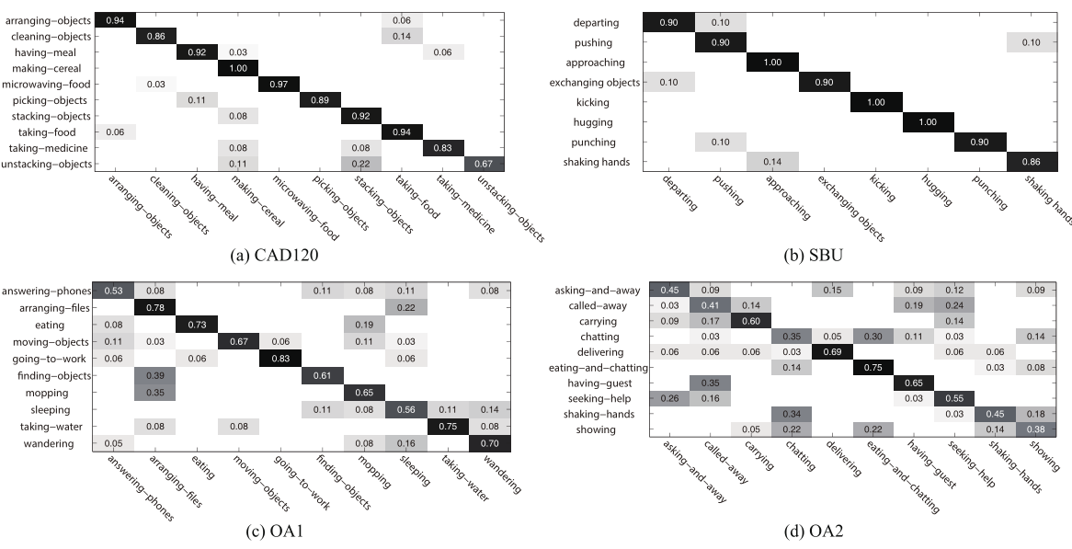
Experimental Results
Notes:
Our model obtains superior performance!
The depth data has much smaller variance, and does help to capture the motion information.

Slide 40
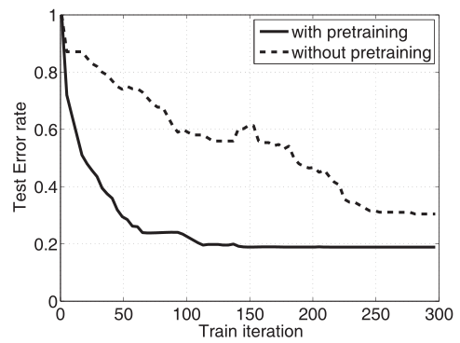
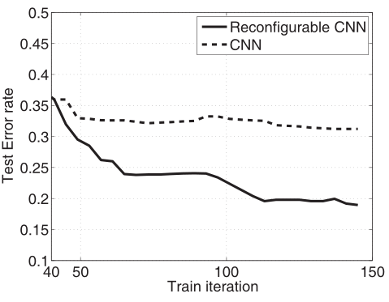
Empirical Analysis
With/without using the pre-training
With/without incorporating the latent structure
Notes:
This experiment is executed on the OA1 dataset.
Test error rate is one minus the classification accuracy.
1) It is shown that the model using the pre-training converges after 25 iterations, while the other
one without the pre-training requires 140 iterations. More importantly, the pre-training can effectively reduce the error rate in the testing, say 8% less than without the pre-training.
2) We observe that the error rates of the structured model decrease faster and reach to the lower result,
compared with the non-structured model.

Slide 41
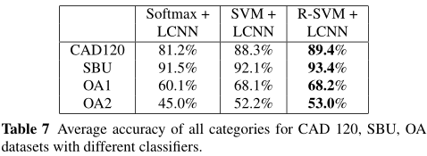
Empirical Analysis
With/without Relaxed Radius-margin Bound.
With/without depth channel.
Notes:
This experiment is executed on the OA1 dataset.
Test error rate is one minus the classification accuracy.
1) It is shown that the model using the pre-training converges after 25 iterations, while the other
one without the pre-training requires 140 iterations. More importantly, the pre-training can effectively reduce the error rate in the testing, say 8% less than without the pre-training.
2) We observe that the error rates of the structured model decrease faster and reach to the lower result,
compared with the non-structured model.

Slide 42
Outline
Background
Related Works
Motivation
Framework
Results
Conclusion

Slide 43
Conclusions
Recognize from raw RGB-D data directly.
Incorporate model reconfigurability into layered convolutional neutral networks
Integrate the radius-margin regularization with the feature learning
Handle well realistic challenges in 3D activity recognition

Slide 44
Thank you!

