Slide 1
Joint Deep Feature and Dictionary Pair Classifier Learning for Object Detection

Slide 2
Outline
Background
Motivation
Proposed Model
Experimental Results
Conclusion

Slide 3
Outline
Background
Motivation
Proposed Model
Experimental Results
Conclusion

Slide 4
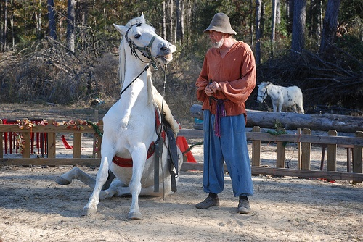
Background
Object Recognition
Which objects and where?
Person
Horse
Horse

Slide 5
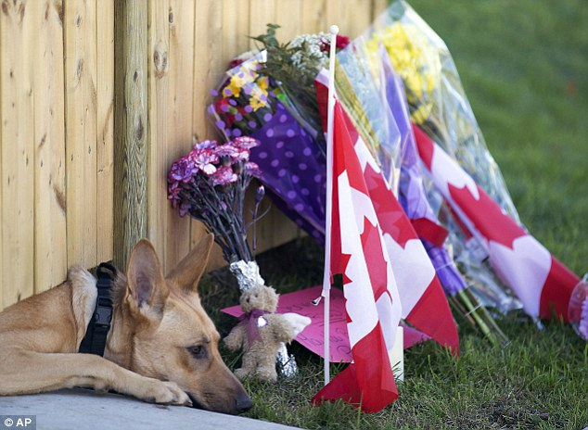
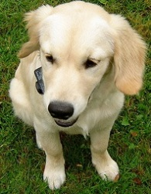
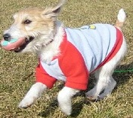
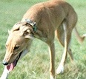
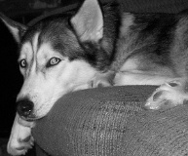
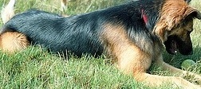
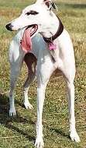
Challenges
The large variation of object appearances
Scene clutter
Changes in shape, scale and viewpoint
Photometric effects

Slide 6
Detect object via Deep Convolutional Neural Networks
Girshick et al.[4] proposed to convert object detection into region classification, and employ CNNs to extract features.

Slide 7
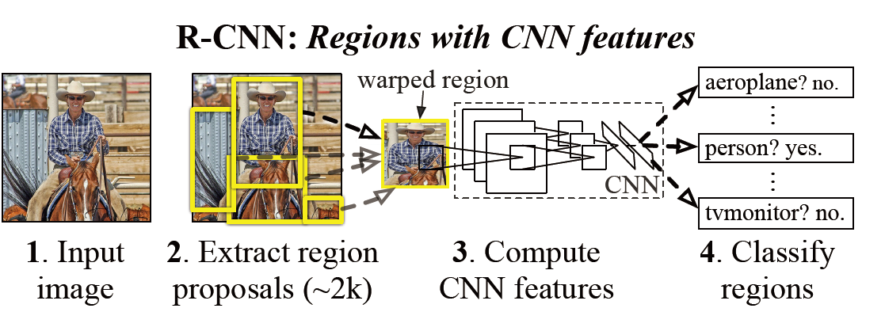
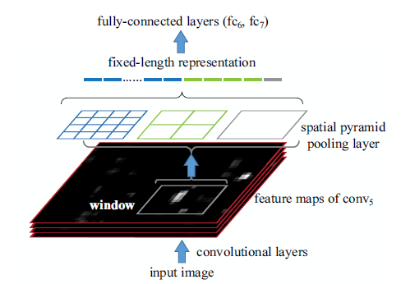
Spatial Pyramid Pooling (SPP)-Net
Kaiming He, Xiangyu Zhang, Shaoqing Ren, Jian Sun, “Spatial Pyramid Pooling in Deep Convolutional Networks for Visual Recognition,” PAMI, 2015.

Slide 8
Outline
Background
Motivation
Proposed Model
Experimental Results
Conclusion

Slide 9
Existing Technical Issue
Recent Studies all focus on developing novel DNNs
Improving classification performance may also be a effective way
Sufficient training data is required
Annotating object is bothering and boring
Semi or even weakly supervised learning strategy is needed to enable object detection for practical use.

Slide 10
Motivation
Joint deep feature and dictionary pair classifier learning
Regard the efficient and effective dictionary pair learning Model [6] as a classifier layer for CNNs.
Propose a joint training mechanism to benefit both feature learning and classifier training

Slide 11
Motivation
Propose a structure model to recognize object in a coarse-and-fine manner
Objectness:
Distinguish objects of any category from the background coarsely
Categoryness:
Calculate the probability belonging to certain object category in a fine manner

Slide 12
Accept By CVPR 2016
Dictionary Pair Classifier Driven
Architecture
Joint deep feature and dictionary pair classifier learning
Recognize object in a coarse-and-fine manner
The four values inside 2*2 grids are corresponding to the four input regions

Slide 13
Dictionary Pair Classifier Layer
${X=[X}_{1},…,X_{k},…,X_{K}]$ denotes a set of the previous layer’s d-dimensional outputs for $K$ object categories;
$W_{k}$ is the importance weight for k-th category training samples.
The goal:
Find an analysis dictionary $P$ and a synthesis dictionary $D$ to analytically code and reconstruct $X$.
Notes:
$\overline{X_{k}}$ denotes the complementary data matrix of $X_{k}$ from the whole training samples $X$.

Slide 14
Dictionary Pair Classifier Layer
Learning of the Dictionary Pair
Notes:
$\overline{X_{k}}$ denotes the complementary data matrix of $X_{k}$ from the whole training samples $X$.

Slide 15
Dictionary Pair Classifier Layer
Dictionary Pair Back Propagation
Notes:
$\overline{X_{k}}$ denotes the complementary data matrix of $X_{k}$ from the whole training samples $X$.

Slide 16
Objectness Dictionary Pair Layer
Objectness
The probability of $x$ covering an object of any category
{$D_{o},P_{o}$} denotes dictionary pairs for object while {$D_{b},P_{b}$} for background.
$$k ∈\{o, b\}$$

Slide 17
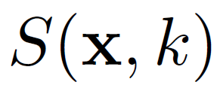
Categoryness Dictionary Pair Layer
Categoryness
Representing how likely the feature $x$ belongs to k-th category
The final object detection score:

Slide 18
Model Fine-tuning
The cost function for training network parameters$ω$ is
Standard Back Propagation is employed
Notes:
Let $φ$ denote the function of the CNN layers and $I_{i}$ denote the input region with the category label $y_{i}$, we have the feature $x$ = $φ$($I_{i}$; $ω$).

Slide 19
Experimental Setting
Datasets PASCAL VOC 2007/2012
20 object categories
Challenging: unbalance, large deformations

Slide 20
Experiment Results
ODP -- Objectness Dictionary Pair layer
CDP -- Categoryness Dictionary Pair layer --
BB -- Bounding Box Regression --
R-CNN (Alex) --R-CNN framework with Alex Net
R-CNN (VGG) -- R-CNN framework with VGG Net

Slide 21
Experiment Results
The significance of dictionary pair back propagation algorithm (DPBP) for fine-tuning the networks.

Slide 22
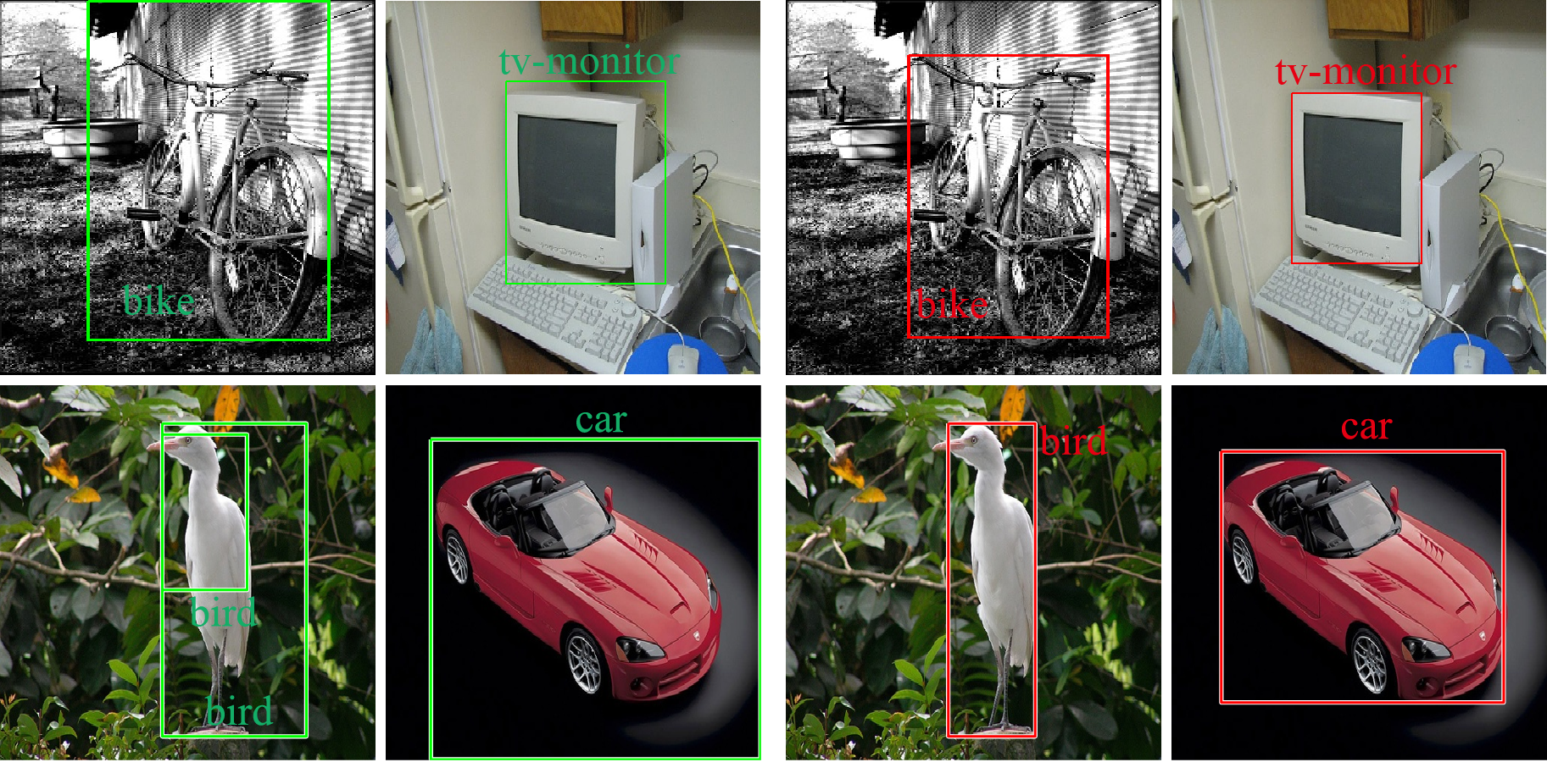
Qualitative Comparison
Our model can localize the bounding box with less background.
R-CNN[4]
Ours

Slide 23
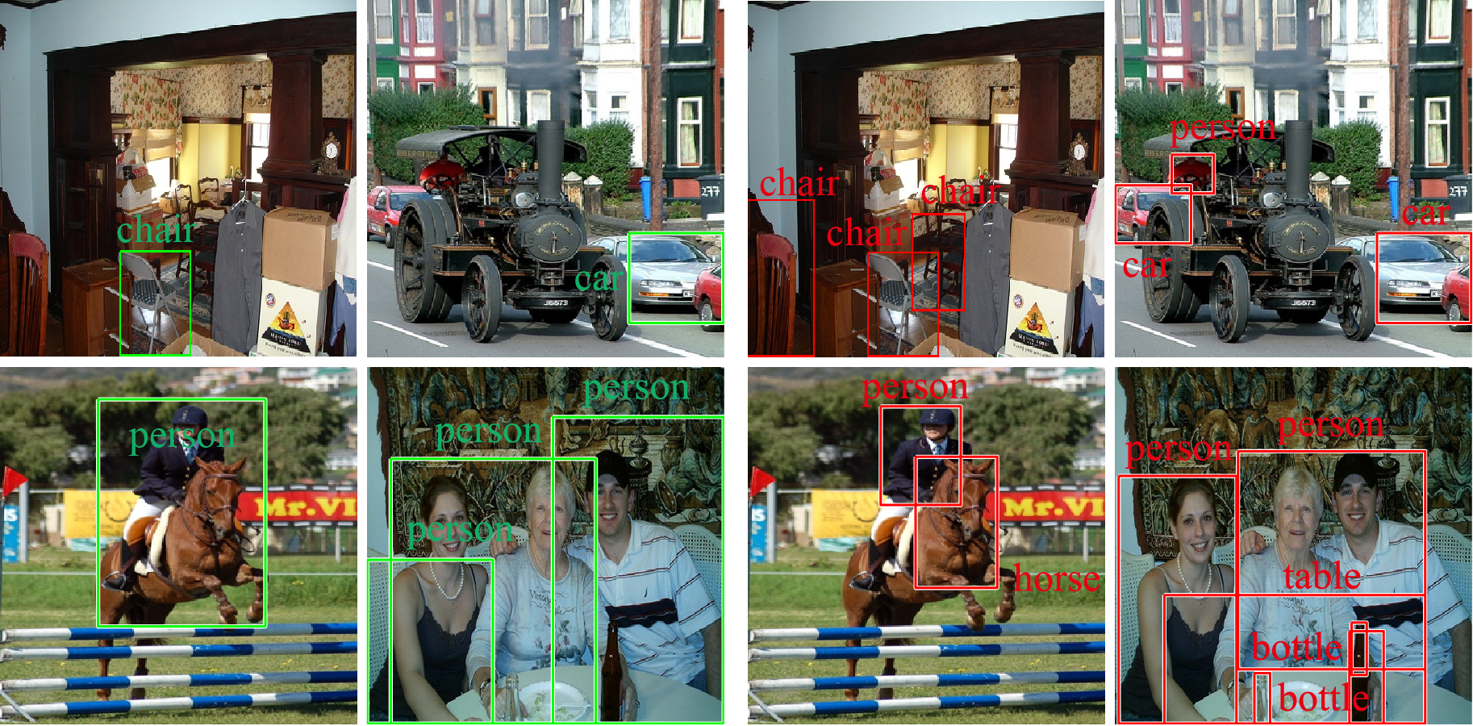
Qualitative Comparison
Our method can recognize more objects
R-CNN[4]
Ours

Slide 24
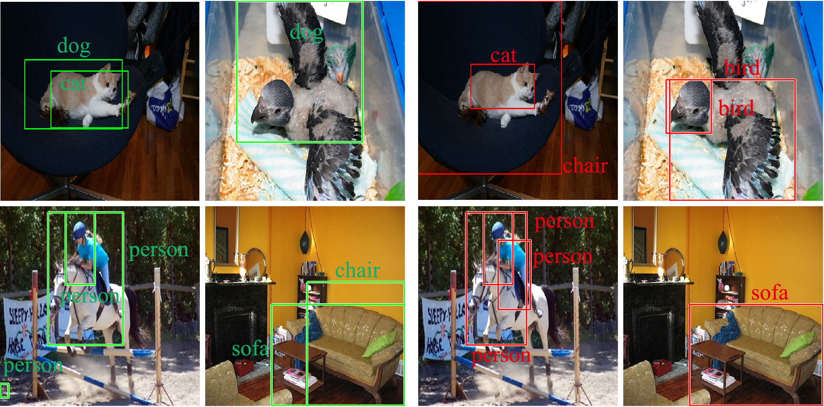
Qualitative Comparison
Our model can obtain better detection results.
R-CNN[4]
Ours

Slide 25
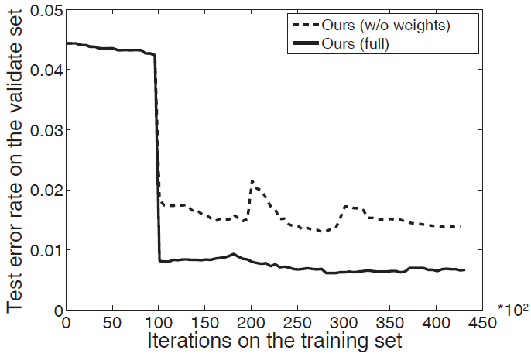
Empirical Analysis
The effectiveness of predefined weights for training samples
Notes:
1) To clarify significance of the proposed dictionary pair back propagation algorithm (DPBP) for fine-tuning the
networks, we fix all the dictionary pairs in ODP and CDP. Under this circumstance, only the parameters of the networks are fine-tuned via the standard back propagation algorithm (BP). Then we denote this model as “BP”, and compare it with the original version “DPBP” on the test error rate, which is defined as one minus the classification accuracy. In Figure. 4, we visualize the test error rates on validation sets with different iterations of the two models from the same initialization. We observe that the error rates of DPBP decreases faster and reaches to the lower error rate after updating the dictionary pair in the 100-th iteration, compared with the dictionary pair fixed.
2) To demonstrate the effectiveness of predefined weights for training samples, we set all weights equal to
1 in our model. That is, the training samples have the same weights during the dictionary pair training inside ODP and CDP. We denote this model as “Ours (equal weights)”, and compare it with the original version “Ours (full)” by test error rate with the same initialization. Every 100 iteration, we optimize the dictionary pairs in both ODP and CDP. As illustrated in Figure , the test error rates of “Ours (without weights)” increase significantly when training dictionary pairs on the 200-th and 300-th iterations, compared with the original version. This reason is that the category specific dictionary pair tries to represent the parts of other category or background inside the training examples. By means of regarding the IoU as the predefined weights of training samples, this phenomenon can be suppressed to some extent. From Figure. 5, one can see that the introduced weights can make the training phase stable and achieve a lower error rate.

Slide 26
Conclusion
Present a joint deep CNN feature and dictionary pair classifier learning framework.
Develop a deep structure model to detect objects in a coarse(objectness) and fine (categoryness) manner.

Slide 27
Thank you!

Slide 28
Reference
[1] P. F. Felzenszwalb, R. B. Girshick, D. McAllester, and D. Ramanan, “Object detection with discriminatively trained partbased models,” PAMI, 2010.
[2] K. E. van de Sande, J. R. Uijlings, T. Gevers, and A. W. Smeulders, “Segmentation as selective search for object recognition,” in ICCV, 2011.
[3] X. Wang, M. Yang, S. Zhu, and Y. Lin, “Regionlets for generic object detection,” in ICCV, 2013.
[4] R. Girshick, J. Donahue, T. Darrell, and J. Malik, “Rich feature hierarchies for accurate object detection and semantic segmentation,” in CVPR, 2014.
[5] Kaiming He, Xiangyu Zhang, Shaoqing Ren, Jian Sun, “Spatial Pyramid Pooling in Deep Convolutional Networks for Visual Recognition,” PAMI, 2015.
[6] S. Gu, L. Zhang, W. Zuo, and X. Feng. “Projective dictionary pair learning for pattern classification,” In Advances in neural information processing systems, 2014.

