Slide 1
Accepted by TPAMI 2017
Active Self-Paced Learning for Semi-supervised Visual Detection
WANG Keze
kezewang@gmail.com
http://kezewang.com

Slide 2
Outline
Background
Motivation
Framework
Experiments
Conclusion

Slide 3
Background
Sample Mining
Employ large amount of unlabeled samples to boost performance
Notes:
Illustration of high- and low-confidence samples in the feature space. (a) shows a few
instances of different object categories, and these instances have large appearance variations. (b)
illustrates how the samples distribute in the feature space, where samples of high classification
confidence distribute compactly to form several clusters and low confidence samples are scattered
and close to the classifier decision boundary.

Slide 4
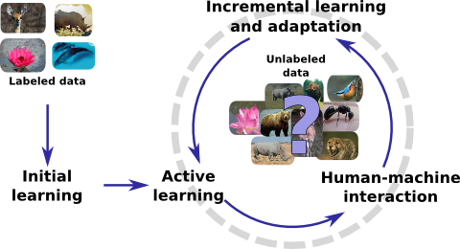
Background
Active Learning
Inspirations from human learning modes
Self-exploring by progressively incorporating knowledge
Expanding knowledge by human-machine communication

Slide 5
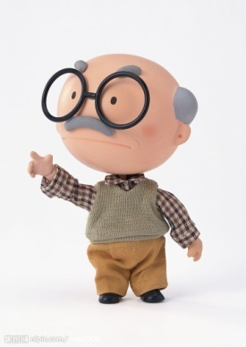
Background
Self-paced Learning: Learn from Easy to Hard
Easy Training Samples
Simple while Faithful Knowledge
……
……
……
……
……
……
……
……
……
……
……
……
Difficult Training Samples
Sophisticated and comprehensive Knowledge

Slide 6
Background
Active Learning
Strength: avoiding unnecessary and redundant annotation
Weakness: insufficient training data
Self-paced Learning
Strength: robust to outliers
Weakness: designed for full supervised learning
Complementarity between AL and SPL
Notes:
The SPL methods emphasize easy samples in learning, which correspond to the high-confidence intra-class samples, while AL inclines to pick up the most uncertain and informative samples for the learning task, which are always located in low-confidence area near classification boundaries

Slide 7
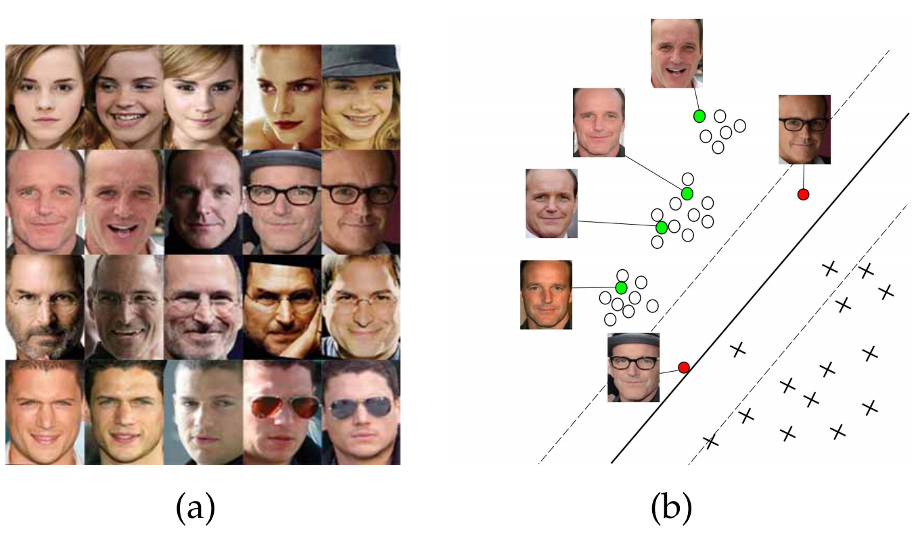
Motivation
Sample Mining
How the sample distribute in the feature space
High- and low-confidence samples
Notes:
Illustration of high- and low-confidence samples in the feature space. (a) shows a few
instances of different object categories, and these instances have large appearance variations. (b)
illustrates how the samples distribute in the feature space, where samples of high classification
confidence distribute compactly to form several clusters and low confidence samples are scattered
and close to the classifier decision boundary.

Slide 8
Motivation
Cost Less
For high-confidence samples -- pseudo-labeling in such a self-paced manner.
For low-confidence samples-- active user annotating.
Earn More
Suppress Incorrectly annotated samples due to the compactness/consistency of majority high-confidence samples.

Slide 9
Framework: Cost-Less & Earn-More
High-confidence sample labeling by Pseudo-labeling
Low-confidence sample annotating by active user annotating

Slide 10
Model Formulation
To
Adaptively handle both manually annotated and pseudo-labeled samples;
Progressively fit the consistently growing unlabeled data;
Our model is defined as follows:

Slide 11
Model Formulation
To
Adaptively handle both manually annotated and pseudo-labeled samples;
Progressively fit the consistently growing unlabeled data;
Our model is defined as follows:
Incorporating sample weight V into optimizing.
Support unseen categories

Slide 12
High-confidence Sample Pseudo-labeling
The goal of optimizing sample weights V

Slide 13
High-confidence Sample Pseudo-labeling
Perform pseudo-labeling via V

Slide 14
Low-confidence Sample Labeling
Randomly collect N unlabeled samples in low-confidence area
Predicted positive by more than two classifiers
Predicted negative by all classifiers
Ask active user for manual annotation
Update curriculum constraint
Instructor’s role in human education to guide a student
Notes:
aims to guide a student to involve more informative curricula in learning

Slide 15
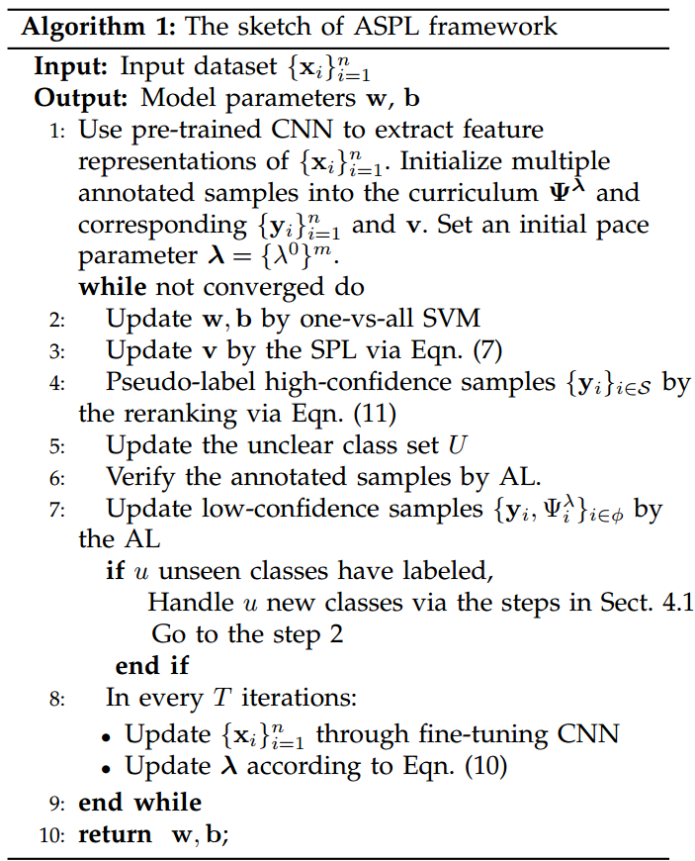
Model Training

Slide 16
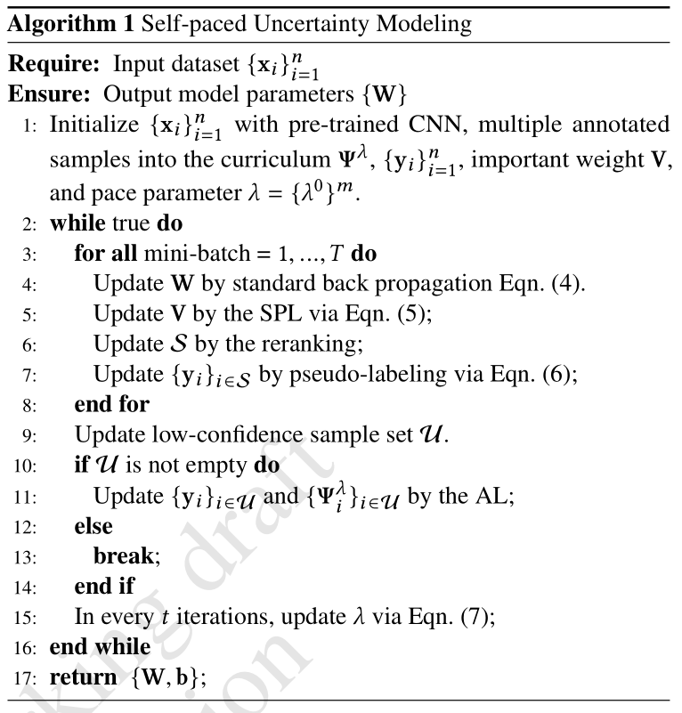
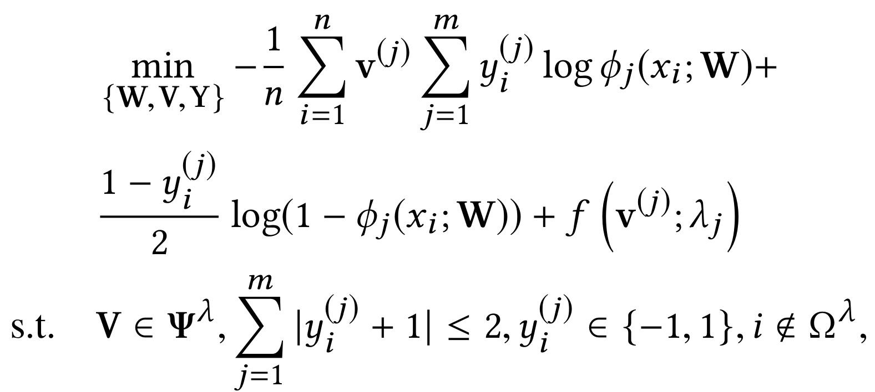
Mini-batch Version
Formulation

Slide 17
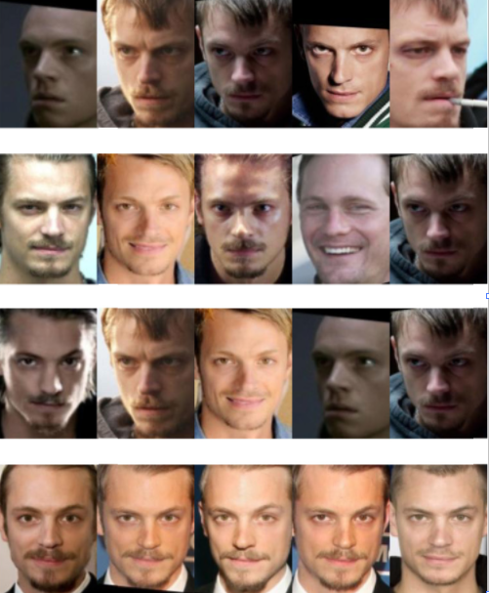
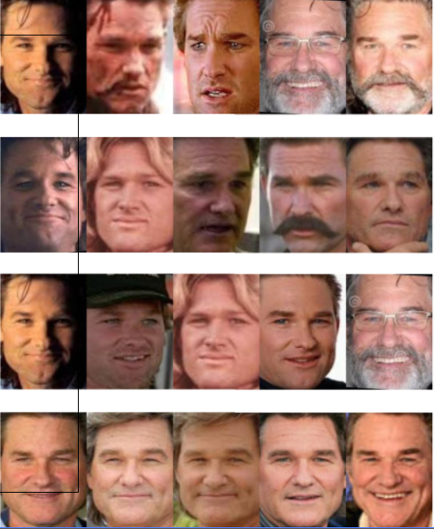
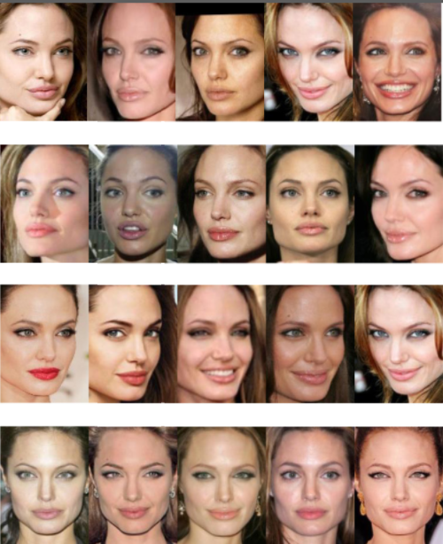
Experimental Setting
Cross-Age Celebrity Dataset
CASIA-WebFace-Sub Dataset
Datasets PASCAL VOC 2007/2012

Slide 18
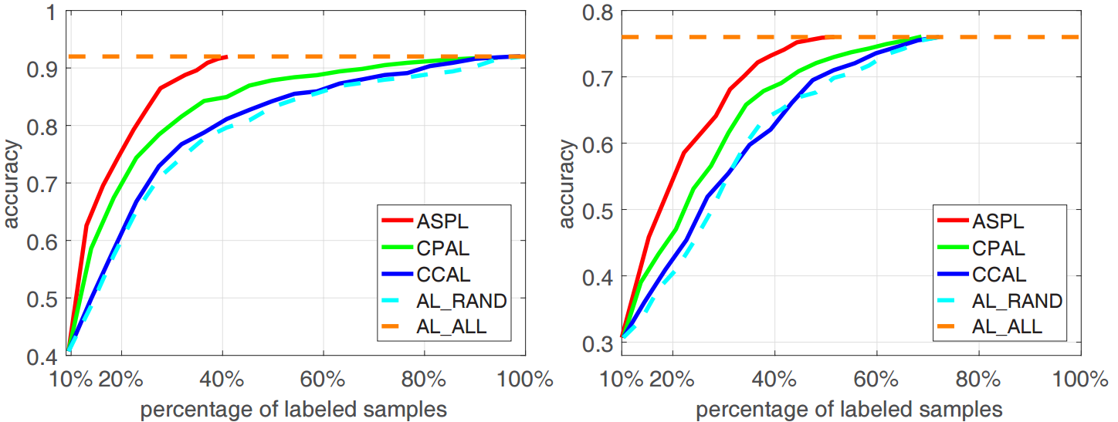
Experimental Results
Cross-Age Celebrity Dataset
CASIA-WebFace-Sub Dataset

Slide 19
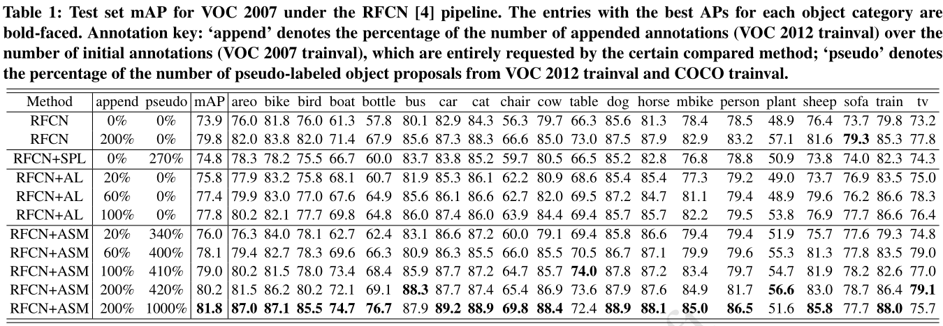
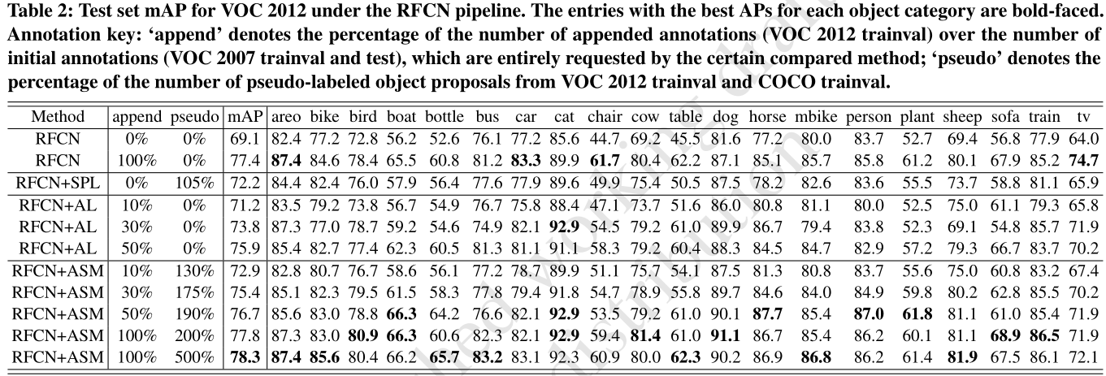
Experimental Results

Slide 20
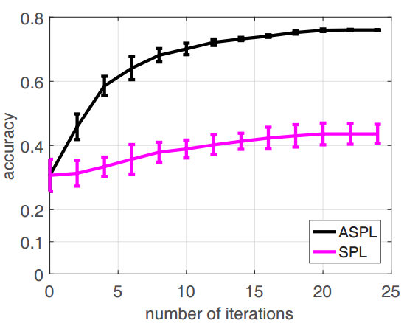
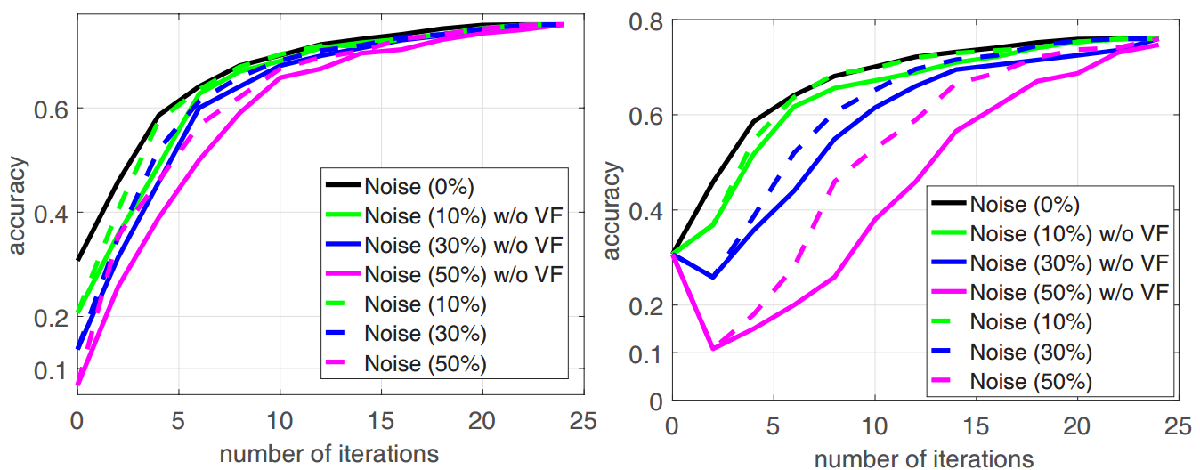
Experimental Results
The accuracy/standard deviation
Two types of noisy samples

Slide 21
Conclusions
Propose an effective semi-supervised face identification framework
Recognize high-confidence faces in a self-paced way
Discover low-confidence ones for user annotation
Progressively annotating and selecting unlabeled faces without suffering from noisy outliers

Slide 22
Thank You!

